Slide 1
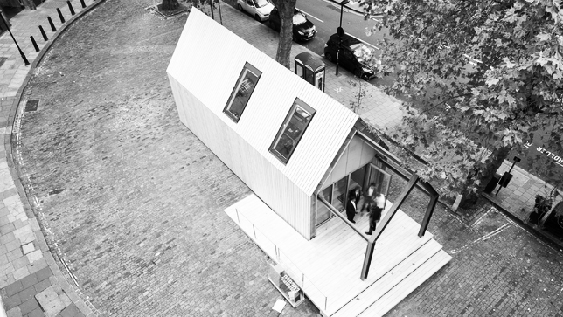



The Circular Economy
& the Construction Sector
Notes:
This introductory session on the Circular Economy (CE) was set up in collaboration between Zero Waste Scotland, City of Glasgow College and Glasgow Caledonian University.
The target audience is lecturing staff in Further Education, with the following aims in mind:
To introduce the topic of CE from first principles.
To illustrate the importance of CE in the construction industry, now and in the future.
To highlight some of the existing examples of CE in construction.
To encourage lecturing staff to think actively about how to incorporate CE into the units they teach and the wider curriculum.
To motivate and inspire the audience on the subject of CE.
For those of you already aware of the topic, this session may contain some interesting new avenues of research and points of discussion.
For those of you new to the topic and terminology therein, it is hoped this session and workshops provide you with a good introductory grounding to the topic.

Slide 2

The Circular Economy
& the Construction Sector
Session 1 (20 mins) - ‘Introduction to the Circular Economy’
Session 2 (20 mins) - ‘Construction and the Circular Economy’
Session 3 (20mins) - ‘Rethinking Business Models in Construction’
- break -
Workshop (1 hr) - Exploration of Examples / Case Studies / Summary
Circular Economy
and the Construction Sector
Notes:
The session will begin with 3 introductory slideshows.
Session 1 will introduce the term / concept Circular Economy from first principles.
Session 2 will be more construction specific and explore how the CE concept applies to the construction industry.
Session 3 looks at CE from an economic point of view and how it provides the opportunity for radical new business models to emerge.
Workshop Session; there will then be a workshop session during which you will be asked to think more broadly about specific CE topics in groups.
Underpinning the above introductory topics is the question of how we can embed the Circular Economy concept within further education. Specifically how can we generate or incorporate CE material into the Built Environment units / modules that we teach. This is something that you should be mindful of throughout the session, and something to reflect upon at the end.

Slide 3
Session 1
Introduction to Circular Economy Principles
The Broad Concept
Legislation & Policy
The Problem of Waste in Construction
Going Beyond Recycling
Circular Economy
and the Construction Sector
Notes:
This is the structure of Session 1, which we will now begin.

Slide 4
Session 1 – Learning Outcomes
Introduction to Circular Economy Principles
On completion of this session you should:
Understand the two opposing concepts of the linear economy and the circular economy.
Be able to describe the linkage between climate change, energy efficiency, renewable energy and the circular economy.
Recognise that the construction sector has the greatest potential to reduce our need for primary material resources.
Circular Economy
and the Construction Sector
Notes:
These are the proposed learning outcomes for this session.

Slide 5
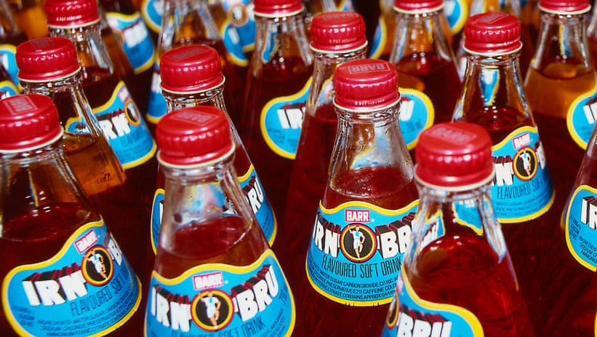
The Broad Concept…
Notes:
Firstly we will define the term Circular Economy, in a broad sense, in order to later discuss how it applies to the construction sector.

Slide 6
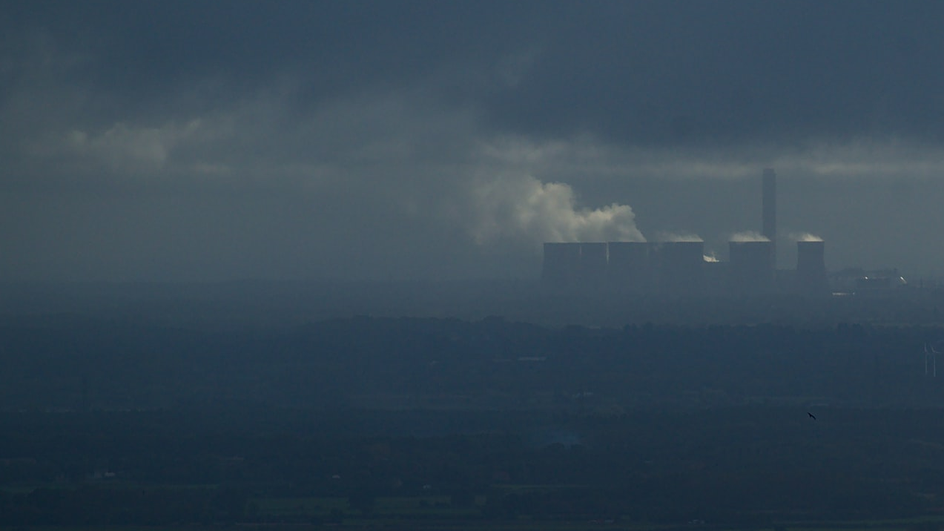
The Broad Concept: The Problem we Currently Face
Latest figures show that the World’s population is due to reach 9.7 billion in 2050.
At this level, the equivalent of 3 planets worth of resources would be required to sustain that population, based on our current lifestyles. (The United Nations)
Key resources are already under severe pressure, such as water and fossil fuels, whilst certain rare elements used in manufacturing and construction are already close to eradication.
Notes:
At present, the population of the World is growing rapidly and our current rate of consumption cannot be sustained. There are due to be 9.7 billion people on the planet in 2050. (https://www.un.org/sustainabledevelopment/sustainable-consumption-production/)
The current societal model of consumptive behaviour would only be sustainable if natural resources were infinite. In the case of our planet, resources are truly finite; it would require 3 planets worth of resources to sustain the population increase that is anticipated, based on our current lifestyles.
Natural resources have been under severe pressure for many years. Worryingly, water and most fossil fuels are among the most significant resources that have become more scarce. Certain other rare earth elements are already thought to be close to eradication. (https://www.theguardian.com/environment/blog/2011/oct/31/six-natural-resources-population)
This current pattern of consumptive behaviour can be described as being at the heart of the Linear Economy. This is the current economic model under which we generally operate.

Slide 7


The Broad Concept: The Linear Economy
Extraction of
Resource
Depletion of Finite
Natural Resources
Manufacturing
Distribution
Consumption
Dispose
Circular Economy
and the Construction Sector
Notes:
The Circular Economy is effectively a model for how we can optimise the value of the world’s resources, reduce waste and consumption of raw materials. In order to understand the Circular Economy concept, we must first illustrate and compare the current, prevalent and long-standing Linear Economy model.
The Linear Economy is still the most common practice in all sectors today, which uses a ‘Take’ – ‘Make’ – ‘Dispose’ model. Within this model the focus is on producing and consuming as inexpensively as possible. As this model expands, we need more raw materials and therefore create more waste. It is not a sustainable model; projected use is far outstripping the limits of the world’s resources. This model is based on the value of goods depleting successively throughout use and ultimately becoming waste. It could be said that waste perpetuates a Linear Economy; the sooner we dispose of something, the sooner our demand for a replacement. This current model encourages wastefulness and is not sustainable.

Slide 8
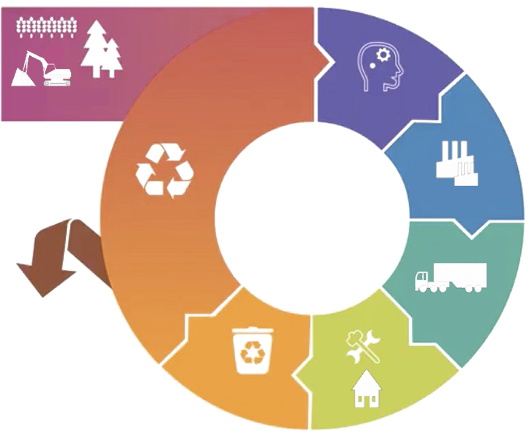
The Broad Concept: The Circular Economy
(Consideration of CE
at Design Stage)
Extraction of
Resource
Manufacturing
Recycling
(Residual
Waste at
Sustainable
Level)
Distribution
Consumption, Use,
Reuse, Repair
Collection
Circular Economy
and the Construction Sector
Notes:
The Circular Economy proposes to overcome the dis-benefits of the Linear Economy model.
In a Circular Economy the value of a resource is optimised. A resource should be used for as long as possible, with maximum value redeemed while in use, and then recovered or regenerated at the end of it’s life. For a Circular Economy to be successful, the attitude to waste must change – waste must be seen as a resource in order to achieve the huge reduction in raw material extraction that is required. As the diagram suggests, the key to achieving the goals of a Circular Economy is to embed the principles at an early design stage across all sectors, and not to simply see it as a waste management issue. Some of you may be familiar with the ‘Cradle to Cradle’ concept in sustainable design, which Circular Economy models build upon. This concept also has great potential to reduced embodied energy or embodied carbon, as will be explained in more detail during this slideshow.
CE works on the basis that as the World’s natural resources and raw materials run out, they become progressively more expensive. Thereafter, strategies for optimising resource value or recovering value in existing products will become more favourable.

Slide 9
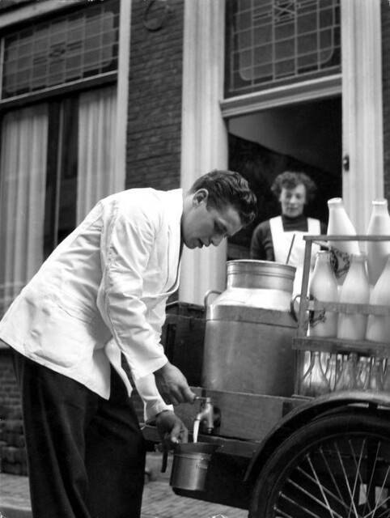
The Broad Concept…
https://www.youtube.com/watch?v=zCRKvDyyHmI
Notes:
In very broad terms, the idea of the milkman delivering milk in bottles that were re-collected, washed and sterilised, then re-filled is an example of a Circular Practice. In order for it to succeed, the provider (milkman) must have the means and facilities to collect, maintain and re-use the glass bottles, whilst the customer must see the benefit too, perhaps in the form of a reduced rate for return of the bottles. These principles will re-appear in later on.
The Ellen Macarthur Foundation has been set up with an aim of accelerating the transition to a Circular Economy, and they have several resources on the topic, such as this introductory video (https://www.youtube.com/watch?v=zCRKvDyyHmI)

Slide 10
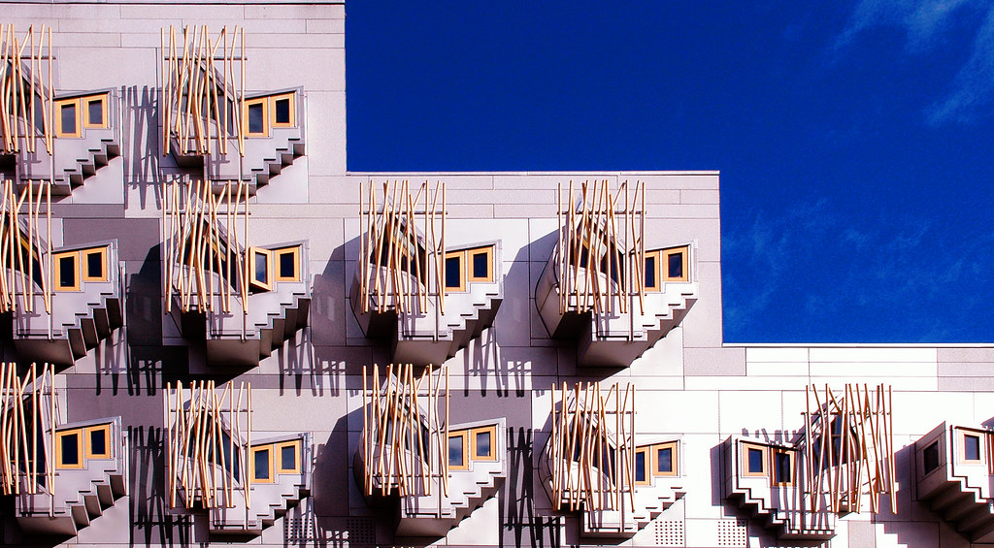
Legislation & Policy
Notes:
At the core of the Circular Economy Concept is an ambition to reduce waste and to extract maximum value from all resources. This essentially aligns with global targets to reduce CO2 emissions, develop renewable technologies and sustain the world’s finite raw materials. This is supported by legislation & policy which will form / does form the direction the future of development.

Slide 11
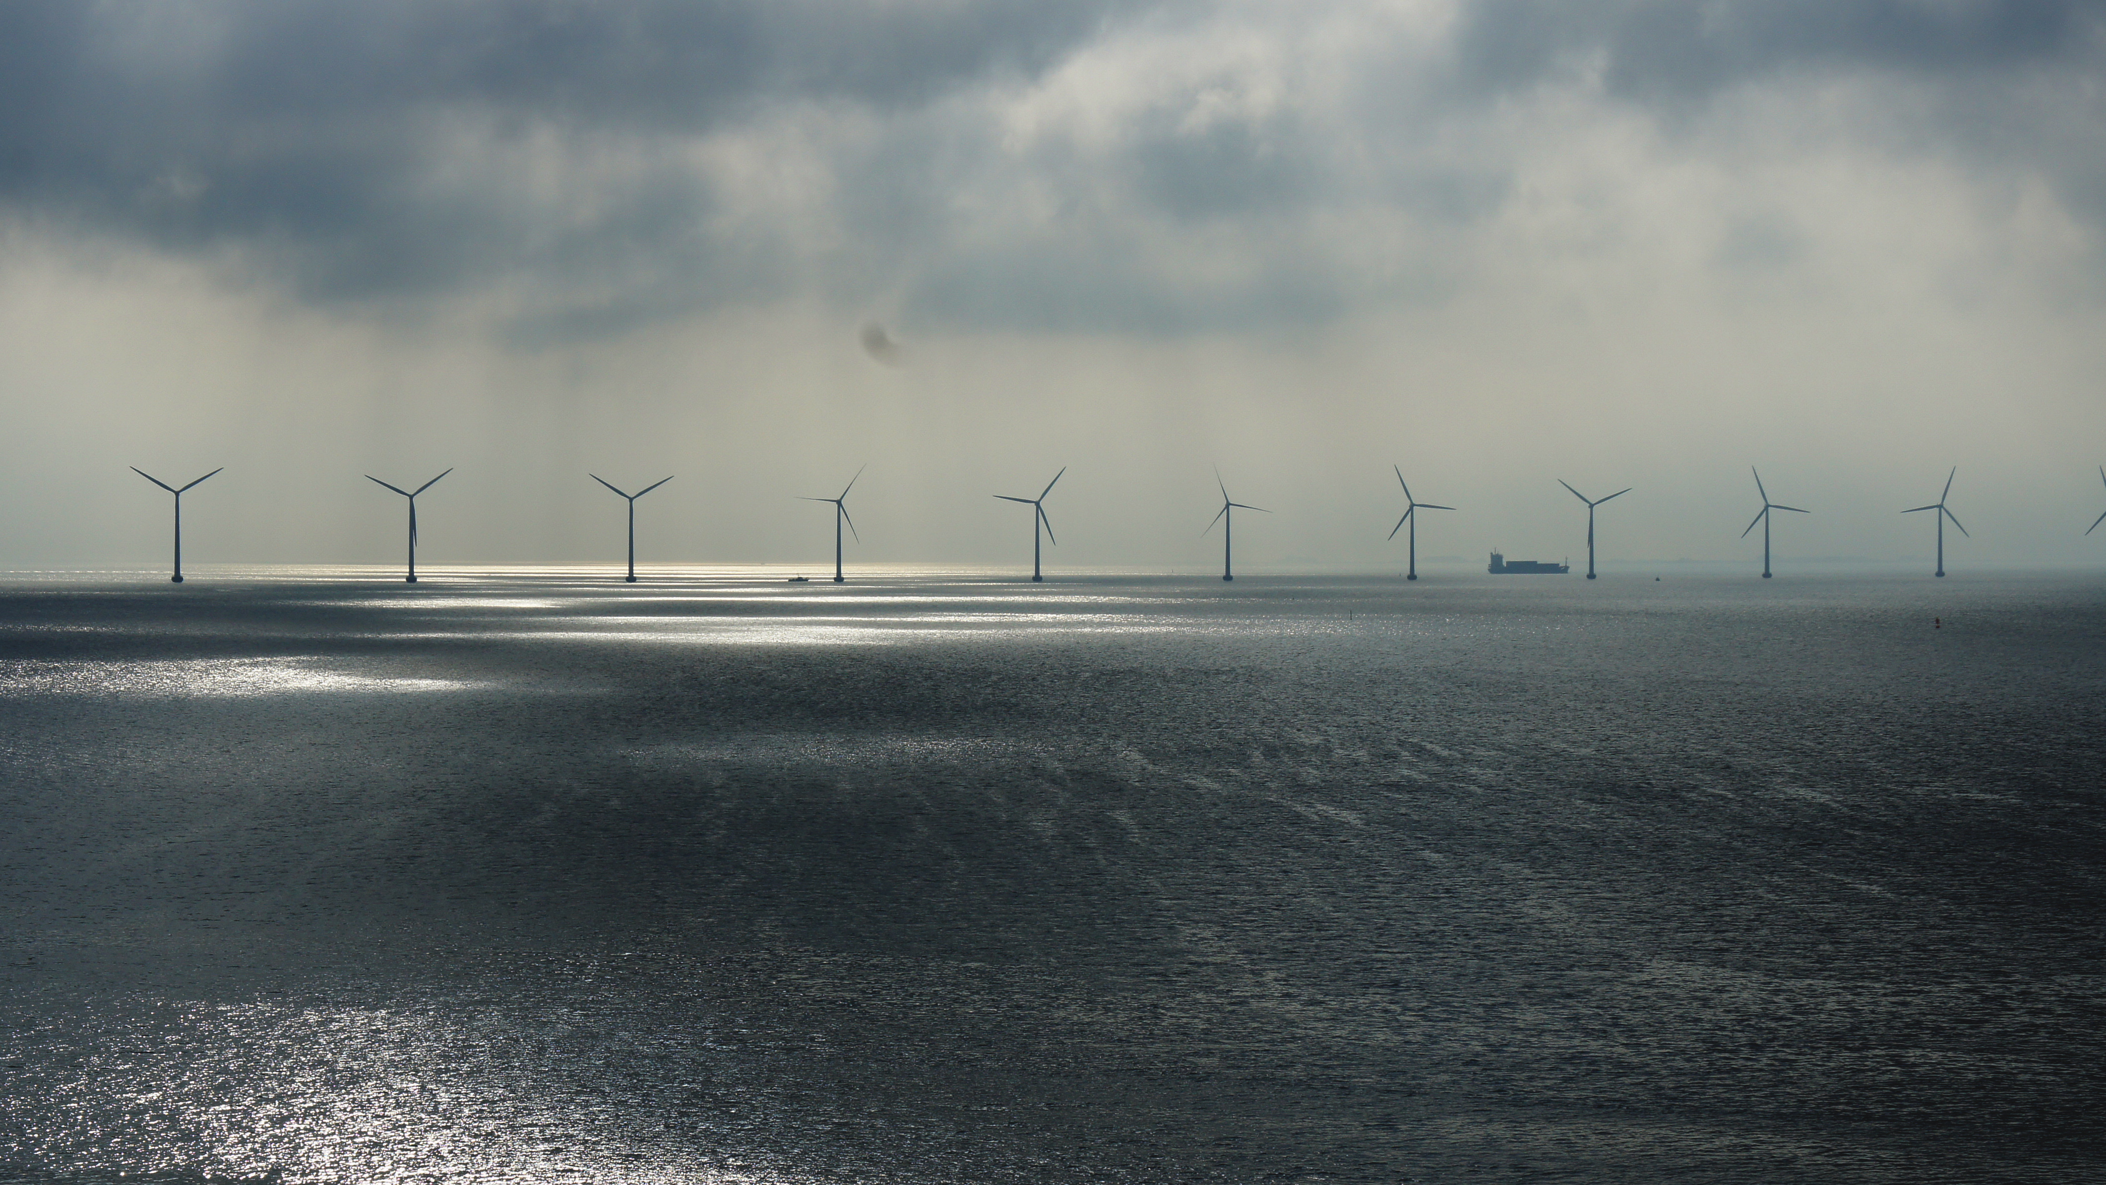
Legislation & Policy
At the core of the Circular Economy concept is the ambition to reduce the use of finite raw materials. This is underpinned and supported by the on-going drive to reduce carbon emissions and develop renewable energy technologies.
Notes:
Firstly we want to remind ourselves what is driving policy development with respect to green / environmental issues.
At the core of the Circular Economy concept is the ambition to reduce the use of finite raw materials. This is underpinned and supported by the on-going drive to reduce carbon emissions and develop renewable energy technologies.

Slide 12

Legislation & Policy
The Circular Economy and the need to tackle Climate Change are interdependent.
The move to renewable energy can only reduce greenhouse gas emissions by 55%. The remaining percentage relates to how we produce goods and food. Production of cement, plastics, steel and aluminium are examples of energy intensive industries that have the opportunity to greatly improve and reduce greenhouse gas emissions.
Notes:
The Circular Economy and the need to tackle Climate Change are interdependent. Moving to renewable energy alone will only reduce greenhouse gas emissions by 55%. The remaining emissions are a result of how we produce goods and food. Production of cement, plastics, steel and aluminium are examples of energy intensive industries that have the opportunity to greatly improve and reduce these emissions. https://www.ellenmacarthurfoundation.org/news/climate-change-paper-released
The reduction in the use of finite raw materials and the drive for renewable energy are at the heart of the circular economy. These are the key areas in which to tackle the climate emergency. Thus, implementing the Circular Economy model will greatly help us to reach our climate change targets.

Slide 13


Legislation & Policy
How these industries reduce their emissions is being driven by the realisation that energy consumption does not just take place at the point of use for a product or service; it occurs across the entire life cycle.
Each stage of the life cycle, indicated on the diagram below, requires energy. We call this lifespan of energy use Embodied Carbon, which is distinct from the Operational Carbon.
EMBODIED CARBON:
Raw Material Extraction
Design
Manufacture
Transport
Use & Maintain (Operational Carbon)
Recycle
Dispose
Notes:
How these energy intensive industries reduce their greenhouse gas emissions will be driven by the realisation that energy use, and resultant harmful carbon emissions, do not just take place at the point of use for a product or service; they occur across the full life cycle.
The ambition to reduce carbon emissions is at the core of current global policy on addressing climate change. Understanding that carbon emissions can be reduced throughout the lifespan of a product or service, and not just at the point of use, will help to identify a holistic approach in addressing this issue. In simple terms, when energy is produced from burning fossil fule, carbon is emitted into the atmosphere. This emitted carbon traps heat within the atmosphere, creating an unnatural rise in global temperatures. This is at the core of climate change policy as the human race is currently releasing severely harmful and unsustainable levels of carbon into the atmosphere.
Consider that the diagram shown represents the lifespan of a light bulb. Each of these stages requires energy, not just the point at which the light bulb is switched on in the home (use & maintain). We call this entire lifespan of energy use Embodied Carbon, which is distinct from the Operational Carbon phase, as shown in the diagram. If we can look at how to reduce energy use throughout the creation, maintenance and disposal phases, we can tackle Embodied Carbon effectively. This should be done in conjunction with reducing energy whilst the product / service is in use, which is a stage that the general population may be more familiar with, for example, switching lights off when nobody is in a room. The example of the light bulb can be applied to any product or service, particularly within the construction industry, and all materials and technologies within it.
The implementation of the Circular Economy will help to deliver targets for Embodied Carbon reductions, across all sectors.

Slide 14


Legislation & Policy
reduce fossil fuel usage
use local
climate change
Developing
Renewable Energy
Reducing Carbon Emissions
CO₂
wind, sun, water…
reduce embodied carbon emissions
circularity
Reducing Use of Finite Raw Materials
reuse / recycle
reduce waste
Circular Economy
and the Construction Sector
Notes:
Energy Efficiency, Renewable Energy, Resource Efficiency are familiar areas of policy that governments have worked on over the past 20 years. These topics and the Circular Economy are all intrinsically linked. These ingredients are embedded within current policy-making and are helping to support each other in working towards a Sustainable & Circular society. For example, CO2 / embodied carbon reduction is an obvious by-product of the Circular Economy, but it is clear that energy will still be needed to support a Circular Economy, which is best served by renewable energy technologies. These key areas of sustainable / circular thinking are interdependent and mutually beneficial initiatives at the core of European and UK policy.

Slide 15


Legislation & Policy
UK: Climate Change Act 2008
The Circular Economy Concept is preceded by this Act.
It was put in place to ensure that UK carbon emissions are reduced to at least 80% below the 1990 baseline rate by 2050.
The Act in itself is a response to global commitments the UK made through the Kyoto Protocol, which acknowledges the effects and cause of Climate Change.
-80%
Circular Economy
and the Construction Sector
Notes:
The Circular Economy Concept is preceded by the UK Climate Change Act 2008. It was put in place to ensure that UK carbon emissions are reduced to at least 80% below the 1990 baseline rate by 2050.
This Act in itself is underpinned by the Kyoto Protocol, which is an International Treaty that acknowledges the effects of climate change and that it is occurring. It also acknowledges the scientific consensus that it is extremely likely that human-made CO2 emissions have caused it. The Kyoto Protocol was adopted in 1997 by several of the major CO2 producing nations, including the UK, and was effective from 16 February 2005. The Paris Agreement, adopted in 2015, builds further on global recognition that climate change must be addressed / reduced.

Slide 16
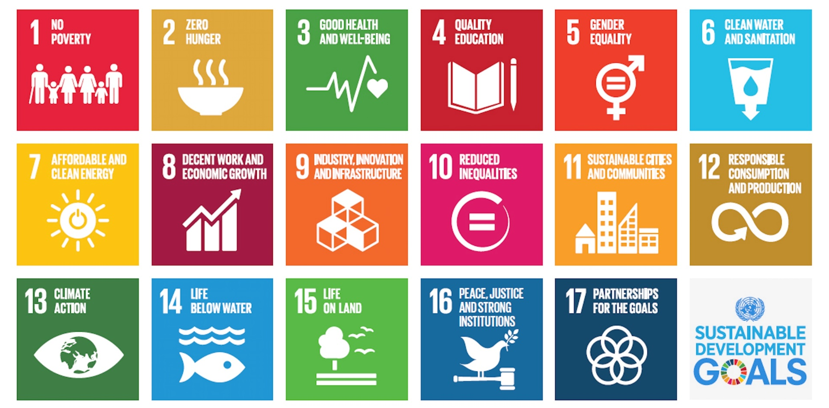
Legislation & Policy
UN: Sustainable Development Goals
Circular Economy
and the Construction Sector
Notes:
Other large global organisations, such as the UN, have supported this legislative drive.
In 2015 the UN General Assembly set targets they wished all UN members to achieve by the year 2030.
Further information in the UN Sustainable Development Goals can be found here: https://www.un.org/sustainabledevelopment/
These targets are to be measured by UN members, to be tracked up until 2030.
These broad targets compliment the principles of the Circular Economy concept.

Slide 17
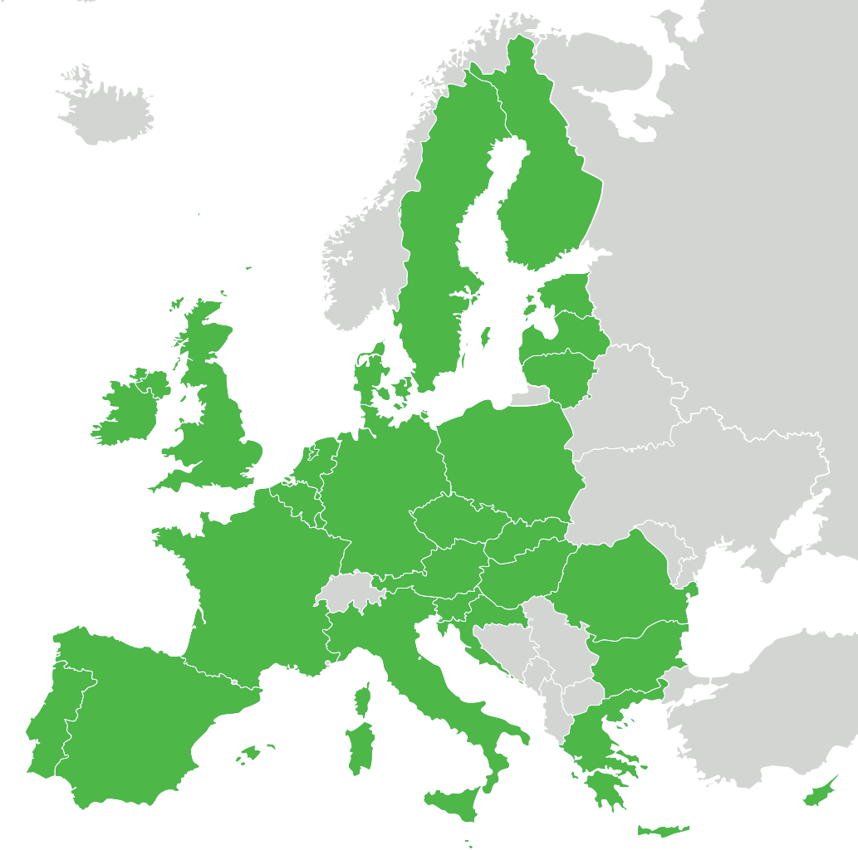
Legislation & Policy
EU: Circular Economy Action Plan
Around 80% of the environmental laws in the UK have been created by the European Union.
The EU Commission have been driving a Circular Economy agenda, culminating in an EU Action Plan for the Circular Economy (2015), putting it at the core of future policy making.
“The Future is not in low cost production…the future is in products that are used and re-used time and time again”
(Frans Timmermans, Vice President of The EU Commission)
https://www.youtube.com/watch?v=a3qIFfyYdzA
Circular Economy
and the Construction Sector
Notes:
Around 80% of the environmental laws in the UK have been created by the European Union.
The EU Commission has developed a Circular Economy Action Plan (https://eur-lex.europa.eu/legal-content/EN/TXT/?uri=CELEX%3A52015DC0614), which ensures that the Circular Economy concept will be at the core of future development in the region. Having been a part of that, the UK has been a subscriber to this way of thinking. A summary of the principles of the Action Plan can be found here (https://www.youtube.com/watch?v=a3qIFfyYdzA). “The Future is not in low cost production, in making things with finite components, the future is providing services that then materialise in products, instead of the other way around. Products that are used and re-used time and time again” (Frans Timmermans, Vice President of The European Commission)
The EU Policy agenda for 2017 onwards includes CE as a priority. EU members are considering the following proposals:
- EU target for recycling 65% of municipal waste by 2030.
- EU to be characterised as a low carbon economy.
- Implement actions leading to innovation and growth.

Slide 18
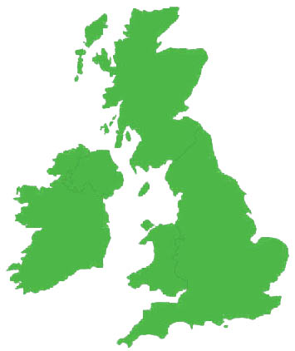
Legislation & Policy
UK Circular Economy Going Forward
The UK Environment Secretary has undertaken to preserve commitments to move towards a Circular Economy following withdrawal from the EU.
The EU Circular Economy policy will be supported by a UK equivalent.
?
Circular Economy
and the Construction Sector
Notes:
The detail of the UK’s position on the Circular Economy in the coming years has been debated by the Environment Journal (https://environmentjournal.online/articles/what-impact-will-brexit-have-on-the-circular-economy/), which suggests that a post-Brexit UK could even go beyond current policy and innovate in relation to the Circular Economy. It is clear that the Circular Economy concept has a strong position at the forefront of the development of future UK Policy, as a result of the previous work of the EU on the Circular Economy Action Plan.

Slide 19
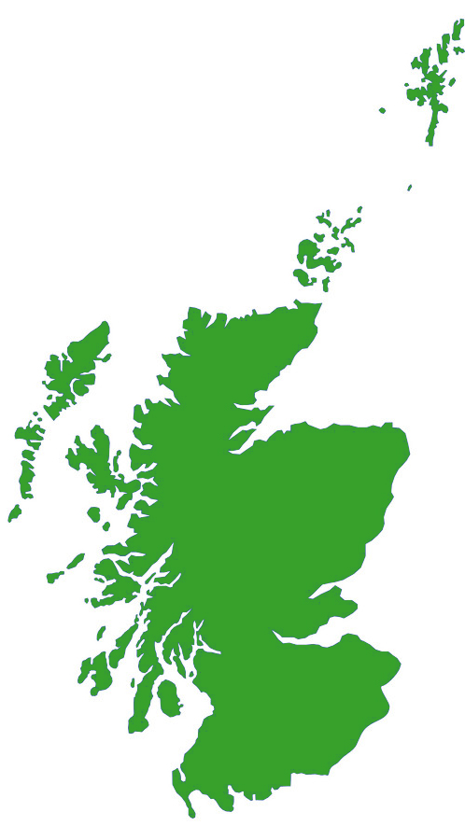
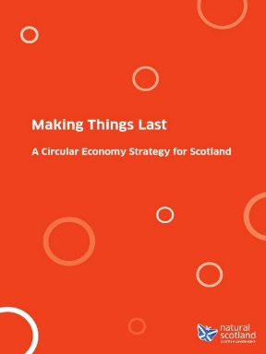
Legislation & Policy
Scottish Strategy: ‘Making Things Last’
Making Things Last (2016) is Scotland’s first Circular Economy Strategy.
It focusses on reducing waste in four key areas:
Food, & Drink and the Broader Bio-Economy
Remanufacture
Construction and the Built Environment
Energy Infrastructure
Circular Economy
and the Construction Sector
Notes:
The Scottish Government are very much on board with the drive towards a Circular Economy. ‘Making Things Last’ is Scotland’s first Circular Economy Strategy, it was published in 2016.
It focusses on reducing waste in four key areas:
Food, & Drink and the Broader Bio-Economy
Remanufacture
Construction and the Built Environment
Energy Infrastructure
(https://circulareconomy.europa.eu/platform/sites/default/files/making_things_last.pdf). It states that Scotland views the Circular Economy as being principally about the Environment, the Economy and People. It recognises that the success of a Circular Economy is about convincing consumers to buy into the principle of CE will determine it’s success. In construction, this will ultimately be the Clients on particular projects, this should be born in mind when we discuss particular examples. Can products or buildings that incorporate reused, remanufactured or recycled solutions be attractive to clients?
The strategy sees CE benefits in following ways:
The Environment: Cutting waste and reducing CO2 emissions
The Economy: Opening up new markets, improving productivity
Communities: Creating opportunities for social enterprise.
It effectively forms a wish list for Circular Economy Policy development in Scotland.

Slide 20




Legislation & Policy
At the Heart of Waste Policy for 20 Years
Recycling targets for construction waste – 70% by 2020
Halving Waste to landfill – construction sector
Love food – Hate Waste
Landfill tax / bans
Several tools and approaches have been developed to support the construction sector tackle waste.
Circular Economy
and the Construction Sector
Notes:
It should also be noted that The Scottish Government have been taking steps towards a more Sustainable Economic Model for a number of years. Scotland’s Zero Waste Plan, published in 2010, set targets and made pledges in a number of policy areas:
Target of 70% recycling and maximum 5% to landfill by 2025 for all Scotland’s waste
Halving of waste to Landfill in the Construction Sector
Development / support of the love food hate waste initiative
Landfill bans for specific waste types
Source segregation and separate collection of specific waste types
Restrictions on inputs to energy from waste facilities
An example of specific policy changes that have been made can be seen in Landfill tax rates. The tax for disposing of Standard waste to Landfill has risen from £7/tonne in 1998 to £89/tonne in 2018. This is an example of a government driven policy that encourages construction professionals to consider the alternatives to disposal and waste on site, but the Circular Economy will need the proposed further advancement of Circular Economy policy support, in order to succeed.

Slide 21

Legislation & Policy
Q: Why is Construction and the Built Environment targeted by the Circular Economy Strategy?
Circular Economy
and the Construction Sector
Notes:
Question: Why is Construction and the Built Environment targeted by the Circular Economy Strategy?

Slide 22
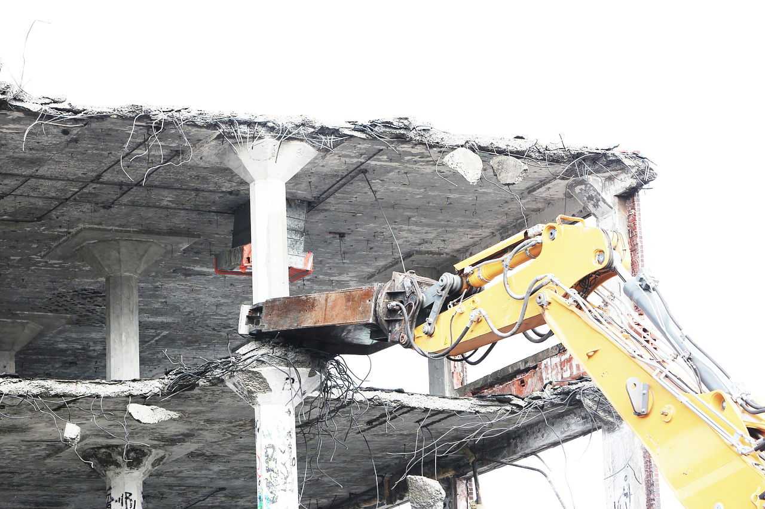
The Problem of Waste in Construction…
Notes:
As one may imagine, the Construction Industry is responsible for a high volume of material waste, which is at present unsustainable.

Slide 23
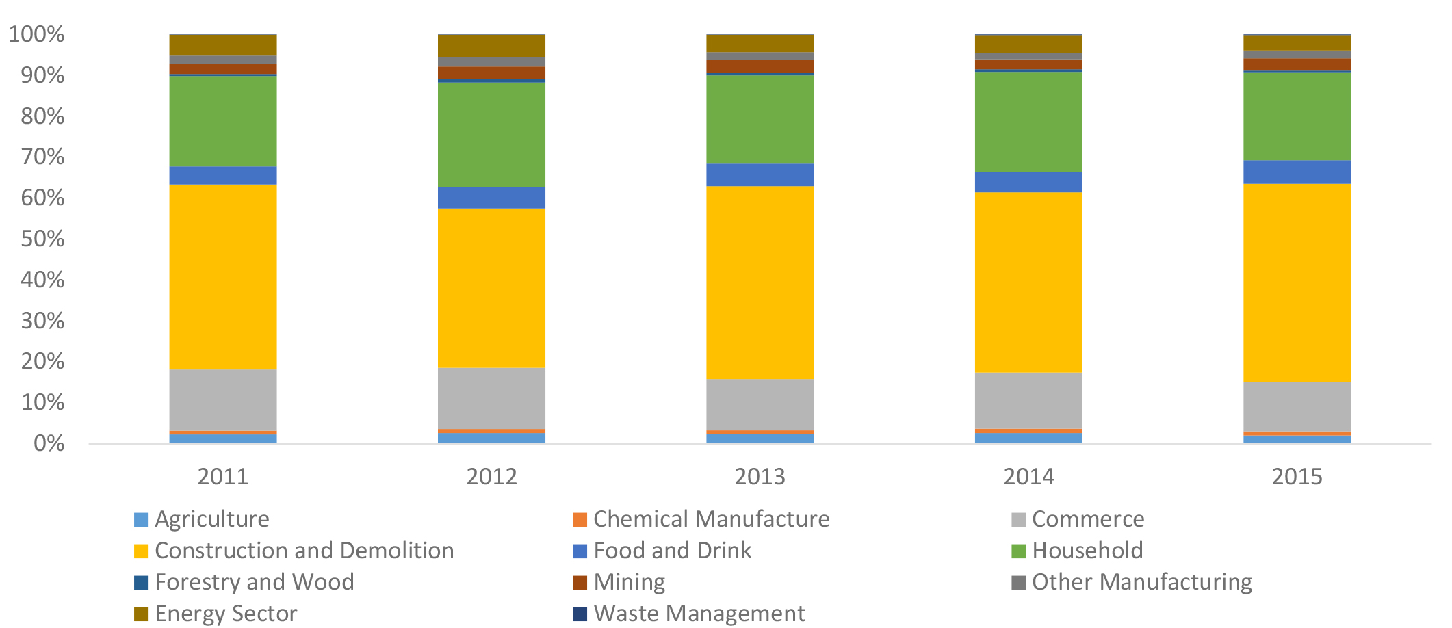
The Problem of Waste in Construction
Share of Waste
Contribution (% Tonnes) of Scotland’s Major Economic Sectors
Source: Zero Waste Scotland (2017)
Circular Economy
and the Construction Sector
Notes:
Generation and disposal of waste is an enormous problem in the world today. The proportion of waste attributable to Construction is shown in the above diagram in yellow, showing the relative waste share (Tonnes) of Scotland’s major economic sectors. “Construction accounts for about 50% of all waste in Scotland and is a major influence on efficient use of resources”, (Making Things Last, Scot Gov, 2016). In fact, Construction, Demolition and Excavation generated around 61% of the total UK waste in 2016 (UK Statistics on Waste, 2016).

Slide 24
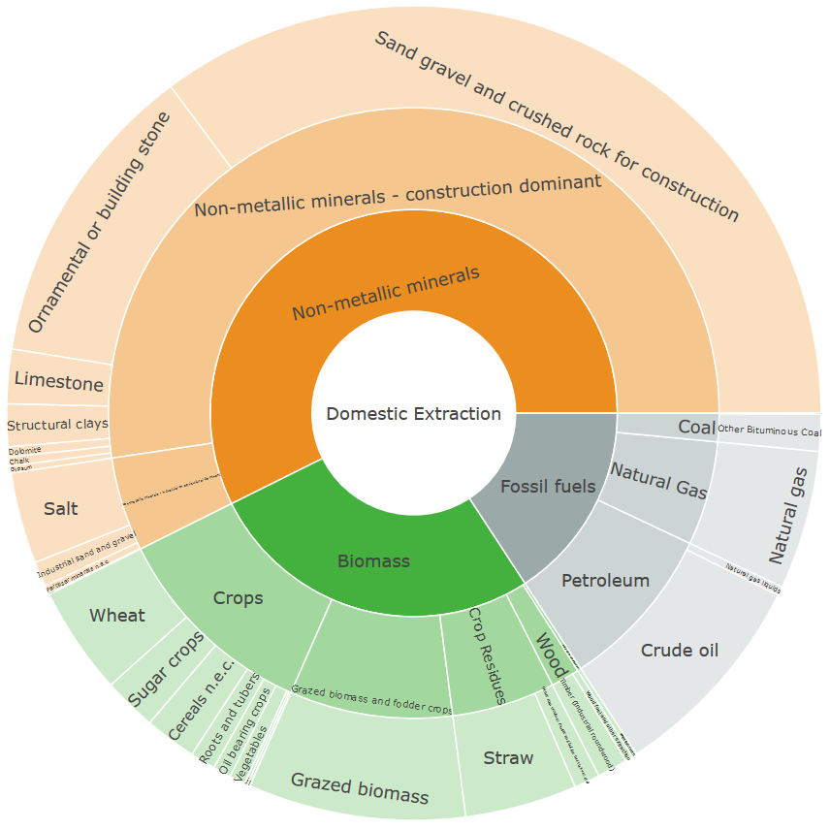
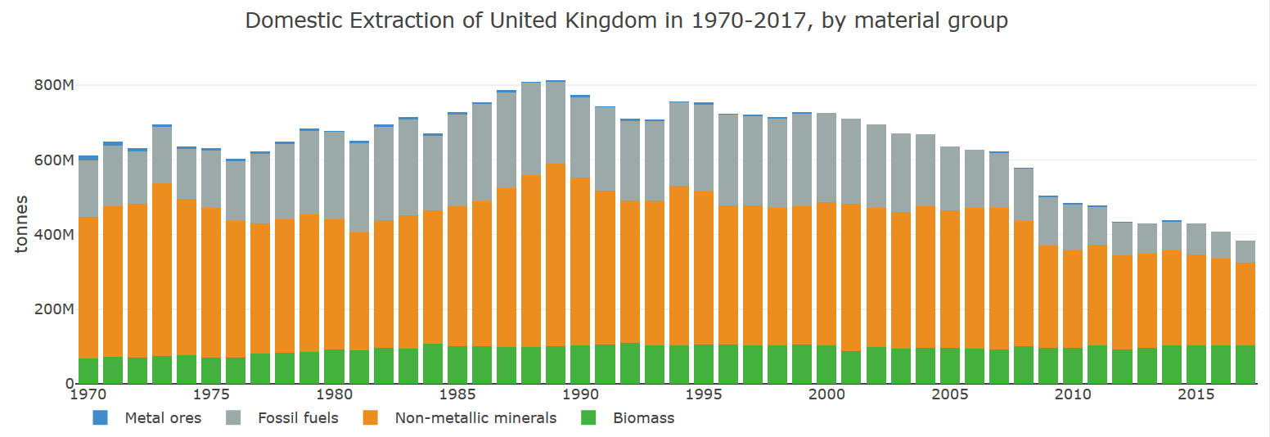
The Problem of Waste in Construction
Extraction of Raw Materials
Volume of Raw Material Extraction by Material Group
Circular Economy
and the Construction Sector
Source: materialflows.net (2017)
Notes:
Whilst our consumption of resources has gone steadily down over the past 50 years, as illustrated in the above graphic, the construction sector remains the largest consumer of natural resources.

Slide 25
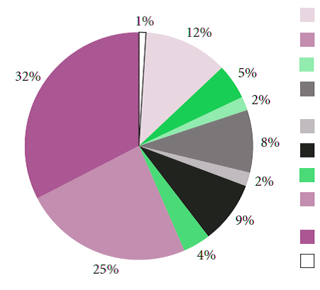
The Problem of Waste in Construction
Types of Construction Material Waste
1%
Wood Products
12%
Finishes, Coatings, Adhesives etc.
5%
Plastic Products
32%
2%
Basic Metals & Fabricated Metal Products
Cabling, Wiring & Lighting
8%
Glass – Based Products
2%
Ceramic Products
Bricks & Other Clay Based Products
9%
Cement, Concrete, Plaster etc.
4%
Stone & Other Non-metallic Mineral Products
25%
Source: OER Commons
Circular Economy
and the Construction Sector
Notes:
The proportions of material waste within the Construction Sector can be seen in the above pie chart. It is also worthy of note that waste source categories include Data Errors, Design Errors, Handling, Weather, Vandalism and Misplacement. It is worth considering how might we reduce waste in each of these categories, which is an aspect of achieving a Circular Economy, and whether technological change in Construction may assist us in this.
For example:
BIM technologies are enabling live overlaying of up-to-date consultant / design information to reduce the occurrence of design / data error.
Just-In-Time procurement of supplies on site by contractors is a method of reducing the instances of weather or vandalism damage in relation to building materials.
But can we go further?

Slide 26
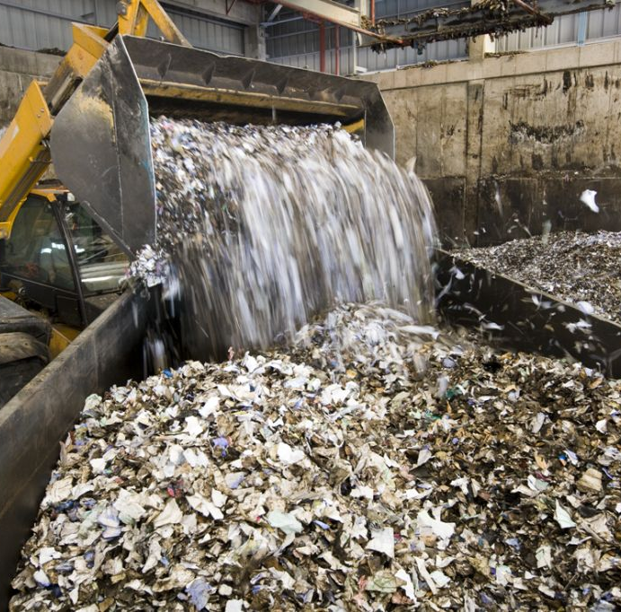
The Problem of Waste in Construction
Waste: The Current Trends
The amount of ‘materials’ used per head of UK population fell from 15.1 tonnes per year to 10.3 tonnes between 2001 – 2013. (Burgess, Matt. 2016)
However, the construction sectors still have much work to do the tonnage of waste produced in the construction sectors increased from 130.3 million to 136.2 million between 2014 – 2016. (Dept. for Environment, Food & Rural Affairs 2019)
Circular Economy
and the Construction Sector
Notes:
There are positive signs that consumption is reducing. The amount of ‘materials’ used per head of UK population fell from 15.1 tonnes per year to 10.3 tonnes between 2001 – 2013.
(Burgess, Matt. 2016). ‘Materials’ includes biomass, metal ores, non-metallic minerals and fossil fuels. However, the construction sectors still have much work to do the tonnage of waste produced in the construction sectors increased from 130.3 million to 136.2 million between 2014 – 2016. (Dept. for Environment, Food & Rural Affairs 2019). This is a 4.5% increase over two years. It should be said that the volume of waste produced is dependent on a number of factors, for example the UK produced less waste during the financial crisis of 2007 / 2008, but it is clear much is still to be done with regards to waste in construction.

Slide 27
The Construction Sector presents the biggest opportunity to reduce waste and move the economy in a ‘Circular’ direction.
Notes:
Given the volume of waste for which the Construction Sector is responsible, it is a Sector that provides the biggest opportunity to reduce waste and move the economy in a ‘Circular’ direction.
The adoption of circular practices in construction, in conjunction with the use of renewable technologies, also has the potential to greatly reduce embodied carbon in construction processes, across entire project life-cycles. Thus helping to achieve the reductions in carbon emissions that global and national policy currently seeks to address.

Slide 28
The Problem of Waste in Construction
Q: What does the Circular Economy involve in practice, in Construction?
Circular Economy
and the Construction Sector
Notes:
This question is aimed at creating a segue into the second session / slideshow. We will delve a little more into this in the second slideshow.
Is anyone aware of any circular practices in construction at present?

Slide 29
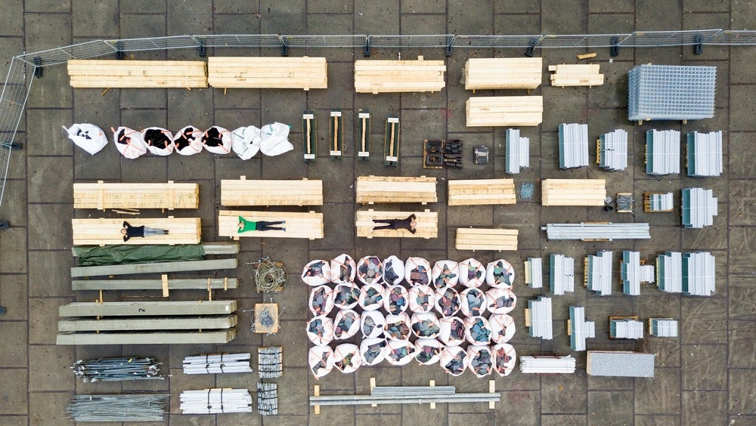
Going Beyond Recyling…
Notes:
This image begins to hint at some of the potential principles of Circular Design in Construction. The idea that this could be the scene both before construction, or following demolition of a building in the future. How can buildings that are designed and detailed to be Circular? How can you design for the preservation of the components of a building? We are all aware of the word ‘Recycling’ and the implications of this, and many of us feel that it is a progressive and environmentally friendly practice. It may be that this is not necessarily always the case…

Slide 30
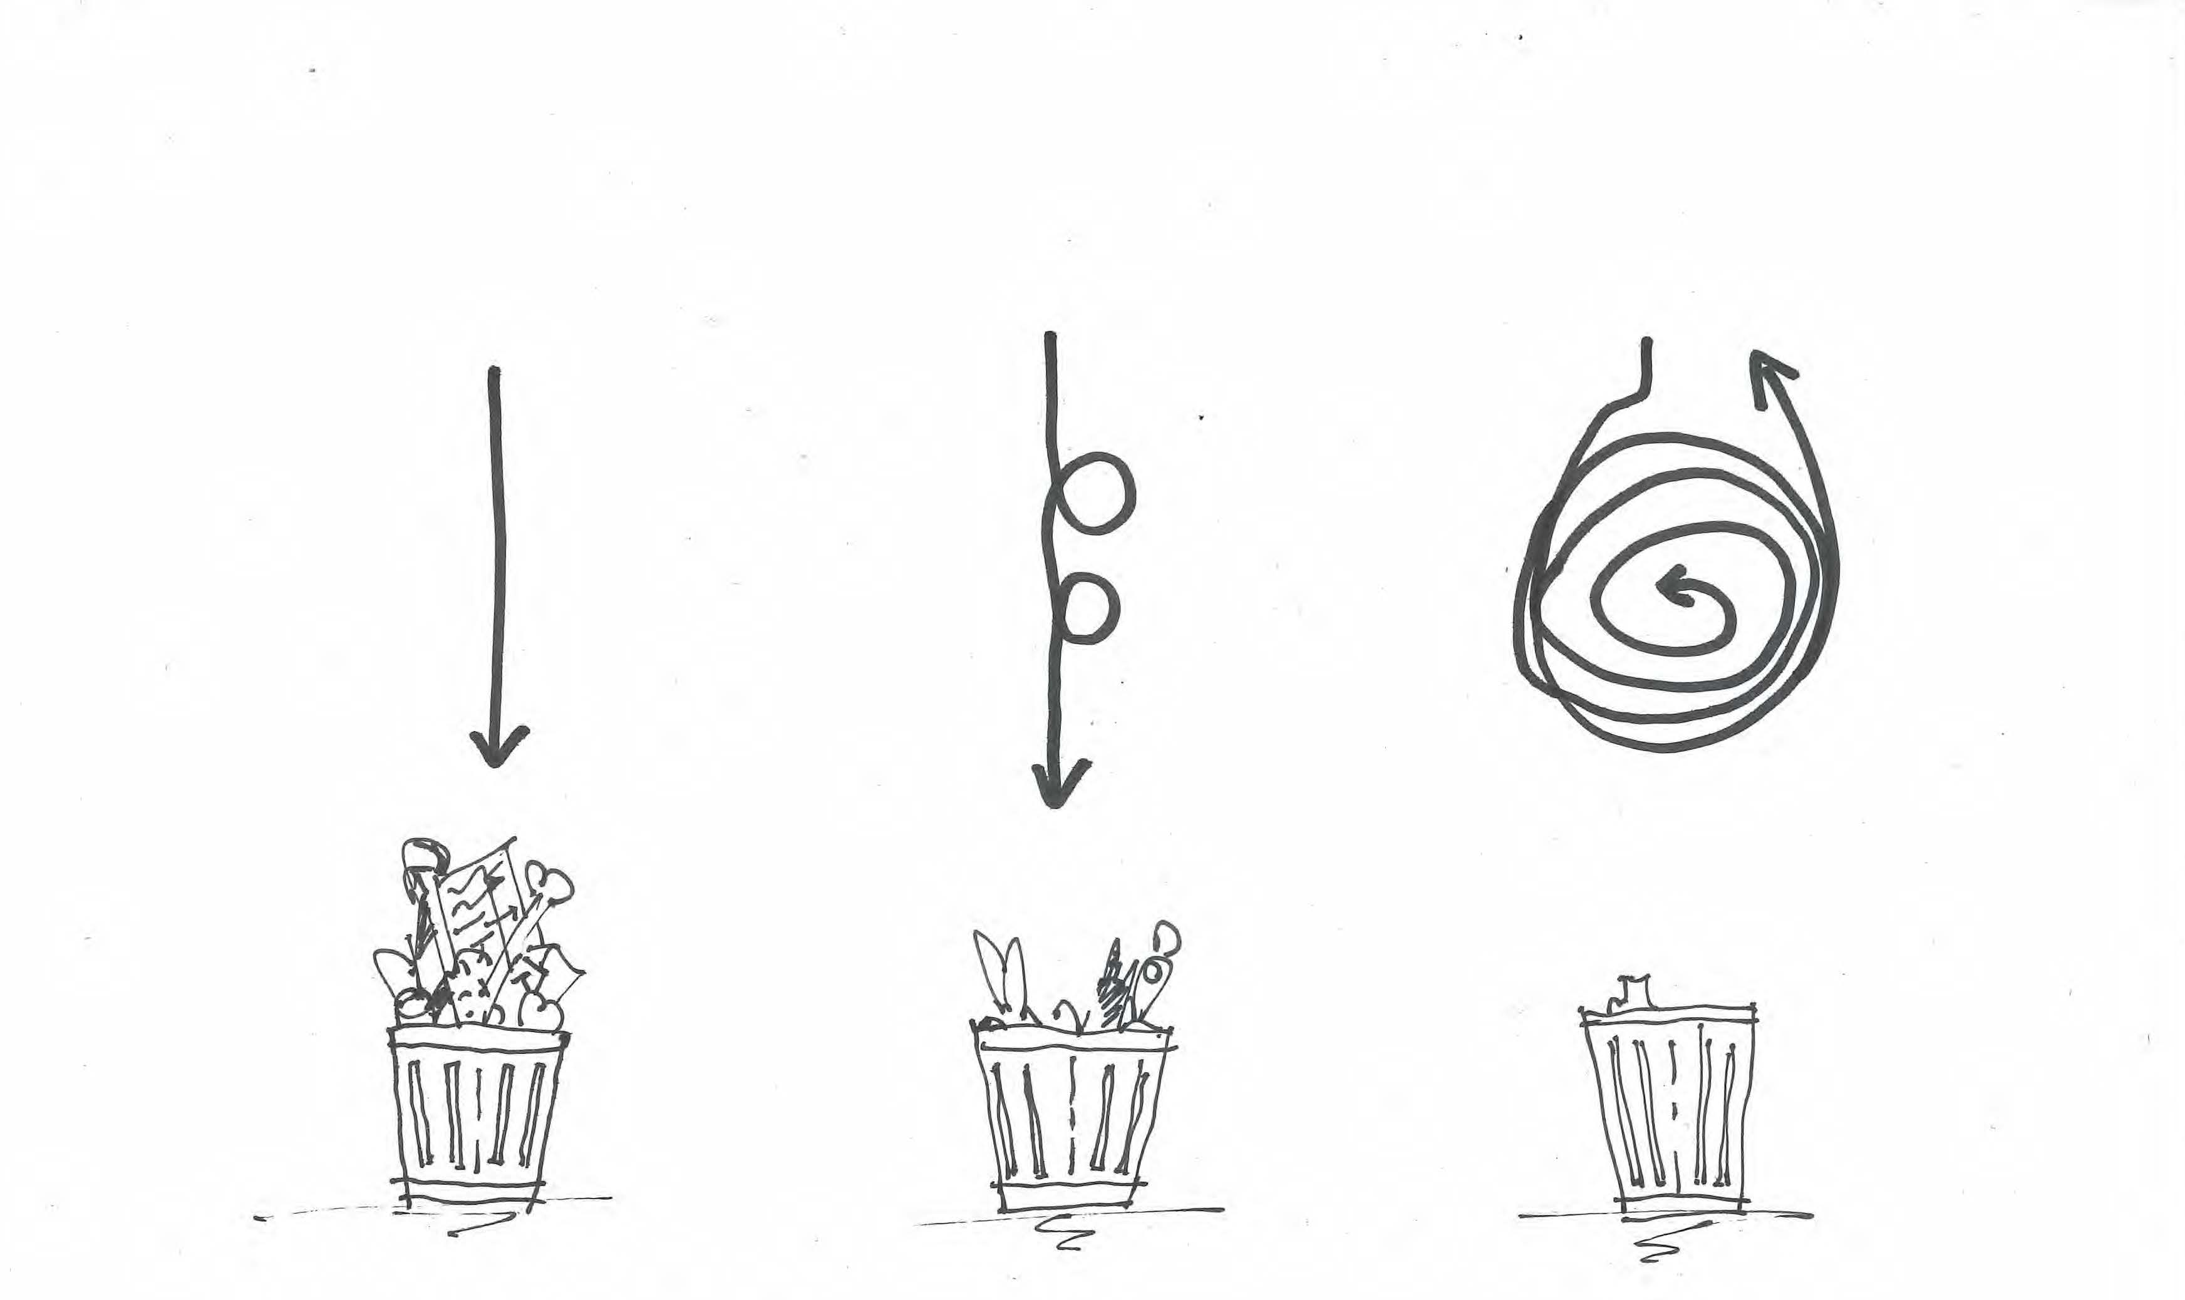
Going Beyond Recycling
Linear
Recycling
Circular
Circular Economy
and the Construction Sector
Notes:
The Circular Economy goes beyond keeping materials in the economy through recycling processes. The now-familiar notion of recycling is in fact not necessarily focussed on extracting maximum value from a product or resource, but simply finding a secondary use. Circular practises aim to secure continual uses of products or resources where possible, and to extend resource life-cycles beyond just secondary uses. Of course, there will still be a level of residual waste in circular processes, but at a greatly reduced level.

Slide 31
Session 1 - Summary
Introduction to Circular Economy Principles
The Broad Concept
Legislation & Policy
The Problem of Waste in Construction
Going Beyond Recycling
Circular Economy
and the Construction Sector
Notes:
A summary of what was covered in session 1, before we move into session 2.

