Slide 1
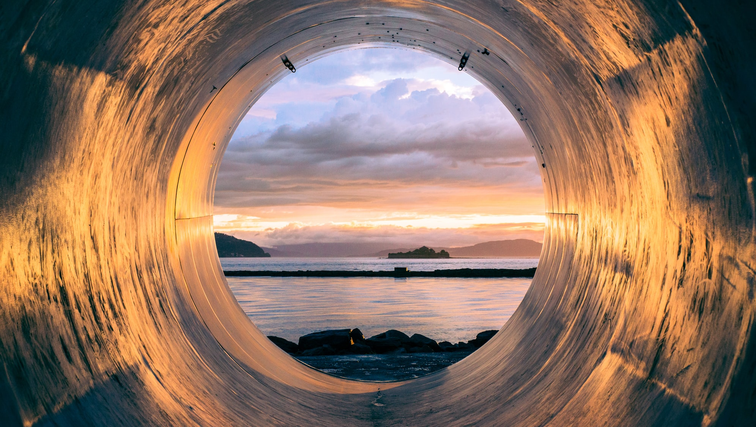



Circular Economy
& the Construction
Sector

Slide 2

Session 3
Rethinking Business Models in Construction
Circular Economy
and the Construction Sector
Notes:
The third and final session, before the workshops, focusses on the business opportunities that would exist within a circular economy. We have looked at the moral and environmental arguments for CE, now we will explore how financially viable businesses could be formed.

Slide 3
Session 3
Rethinking Business Models in Construction
Schools of Thought
Accenture Model
Five Business Models + Case Studies
Circular Economy
and the Construction Sector
Notes:
These are the topics we will cover in session 3.

Slide 4
Session 3
Learning Outcomes
On completion of this session you should:
Have an understanding of the ultimate impact of the current linear economy on Resource Scarcity and Mounting Waste.
Be able to Identify 2 Schools of Thinking in relation to Circular Economy Business Models
Give examples of precedents for different Circular Business models within the Construction Sector.
Circular Economy
and the Construction Sector
Notes:
These are the learning outcomes to be covered in Session 3.

Slide 5
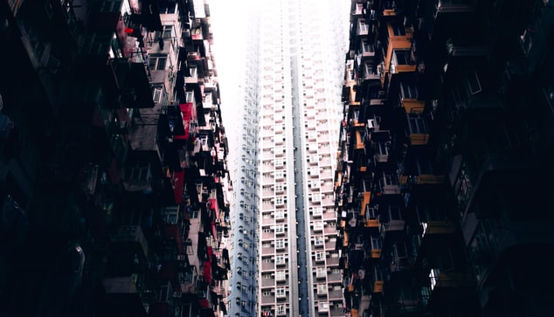
Schools of Thought…
Notes:
There are a number of Schools of Thought that aim to set out clear business strategies for the Circular Economy. These are underpinned by the recognition that Resource Scarcity and Mounting Waste are serious problems that need to be addressed, as discussed throughout this session.

Slide 6
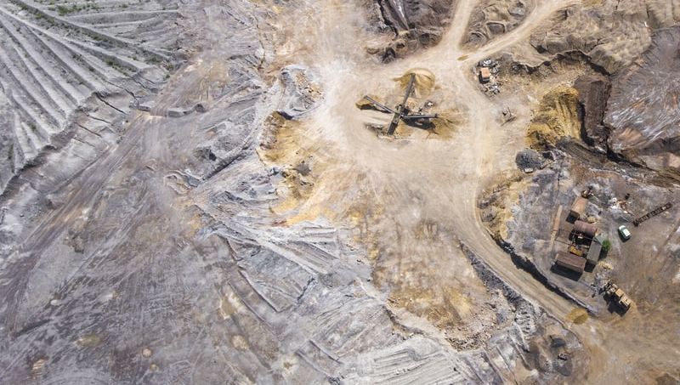
Resource Scarcity
The Circular Economy concept is born from the notion that many of the raw materials that we rely upon are finite and will run out at their current rate of usage.
If we continue in the same, Linear manner, then finite resources will become ever more scarce and expensive, before eventually disappearing for good.
Notes:
Resource Scarcity
The Circular Economy concept is born from the notion that many of the raw materials that we rely upon are finite and will run out at their current rate of usage.
If we continue in the same, Linear manner, then finite resources will become ever more scare and expensive, before eventually disappearing for good.

Slide 7
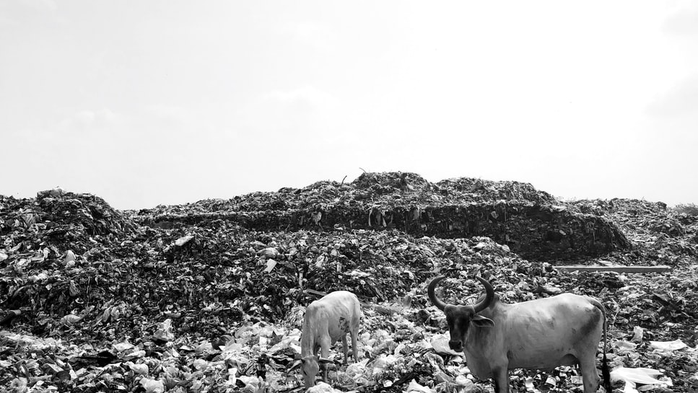
Mounting Waste
The huge volumes of waste produced, in the construction sector especially, is a problem that does not optimise resource value.
Future business models therefore need to align with current policy, reduce resource consumption and offer affordable solutions to consumers.
Notes:
Mounting Waste
The huge volumes of waste produced, in the construction sector especially, is a problem that does not optimise resource value.
Future business models therefore need to align with current policy, reduce resource consumption and offer affordable solutions to consumers.

Slide 8
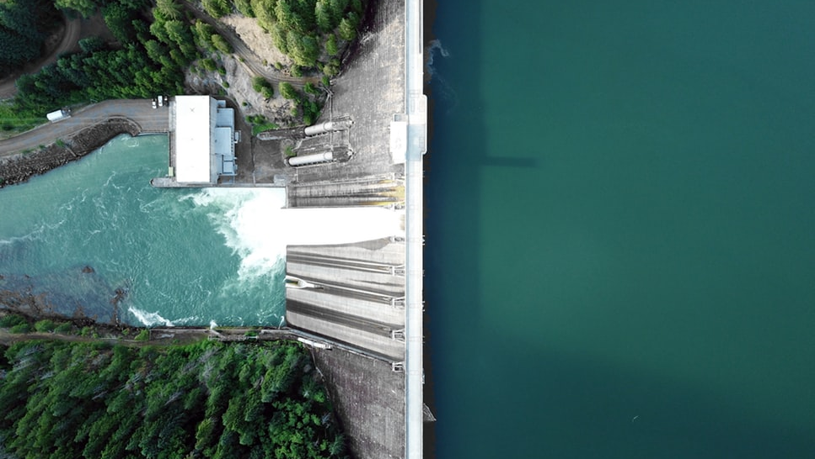
Tools and Concepts
There are tools and method available to support the sector implement a reduce/reuse/recycle approach to construction waste.
However the Circular Economy approach goes beyond this to rethinking the way the sector operates – new and innovative approaches to the construction, use and after-use of buildings.
Notes:
There are a number of tools and methods already available to support the sector implement a reduce/reuse/recycle approach to construction waste management.
However the Circular Economy approach goes beyond this to rethinking the way the sector operates – new and innovative approaches to the construction, use and after-use of building.
There are several Schools of Thought on the subject of the Circular Economy, with regards to how we do business. These all have many things in common; they attempt to succinctly summarise the future business landscape under a Circular Economy.
Introducing one of these Schools of Thought to students, where possible, may help to make an introduction to the topic more digestible.
We are going to look at a School of Thought called the Accenture Model

Slide 9
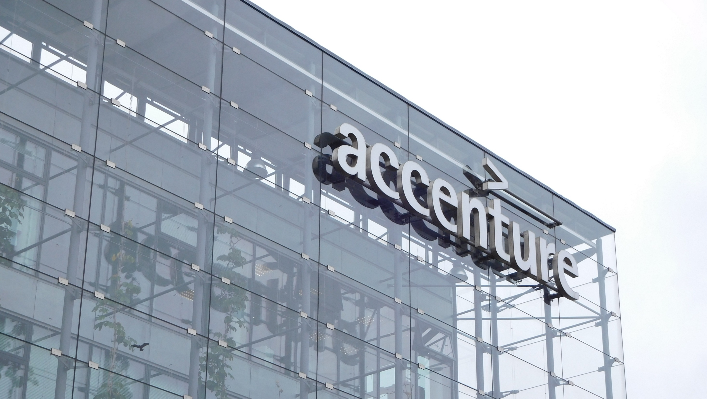
Accenture Model
Notes:
We are going to look at a complimentary School of Thought called the Accenture Model…

Slide 10

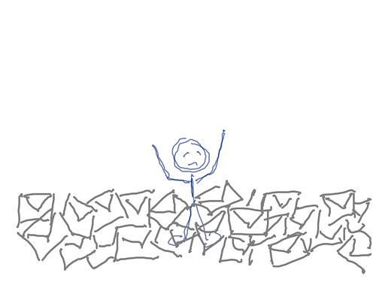
Accenture Model
Starting Point
The world is currently using 1.5 planet’s worth of resources per year, which is unsustainable and will ultimately lead to resource extinction.
“Needless to say, the economic impact of resource scarcity on this scale would be devastating” (Accenture Strategy: Circular Advantage 2014)
Circular Economy
and the Construction Sector
Notes:
Accenture acknowledge the problems identified with the Linear Economy and that it appears to be an increasingly ill-fated model.
They highlight the fact that the world is currently using 1.5 planet’s worth of resources per year, which is unsustainable and will ultimately lead to resource extinction.
The world’s population is growing and the global middle-class is expanding, which is driving a demand for continuous resources, within societies that have grown up around the current linear systems.
They work on the basis that the current Linear Economy is in fact an economic black hole that ultimately results in the elimination of the resources we have become reliant on.

Slide 11

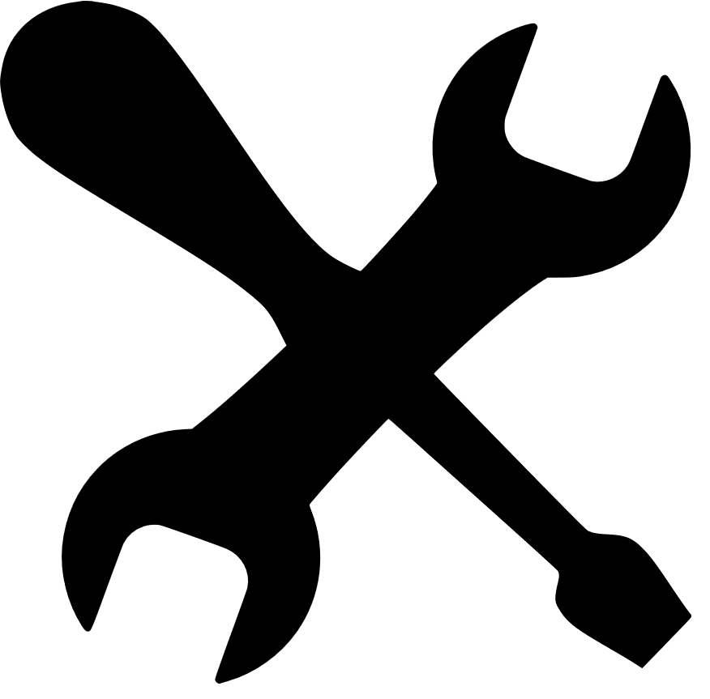



Schools of Thought
Accenture – Five Business Models:
Circular Supplies
Product as a Service
Sharing Platforms
Product Life Extension
Resource Recovery
Circular Economy
and the Construction Sector
Notes:
In response to the predicted resource scarcity and resultant economic crisis that would thereafter occur, Accenture propose 5 business models that provide the opportunity to succeed within a Circular Economy:
Circular Supplies – Where companies work with their customers and suppliers to specify renewable resources and recyclable material input within the supply chain
Product as a Service – To retain ownership of the products and lease their use to customers.
Sharing Platforms – where overcapacity or underutilisation are shared in collaborative partnerships and therefore used more efficiently.
Product Life Extension – The design and manufacturing of products in order to prolong the product’s life
Resource Recovery – Focussing on giving a new life to products at the end of their initial lifecycle.

Slide 12
Accenture Model
Q: Can you describe a construction process or product that may benefit from one of these concepts?
Circular Supplies
Resource Recovery
Product Life Extension
Sharing platforms
Product as a service
Circular Economy
and the Construction Sector
Notes:
Q: Can you describe a construction process or product that may benefit from one of these concepts?

Slide 13
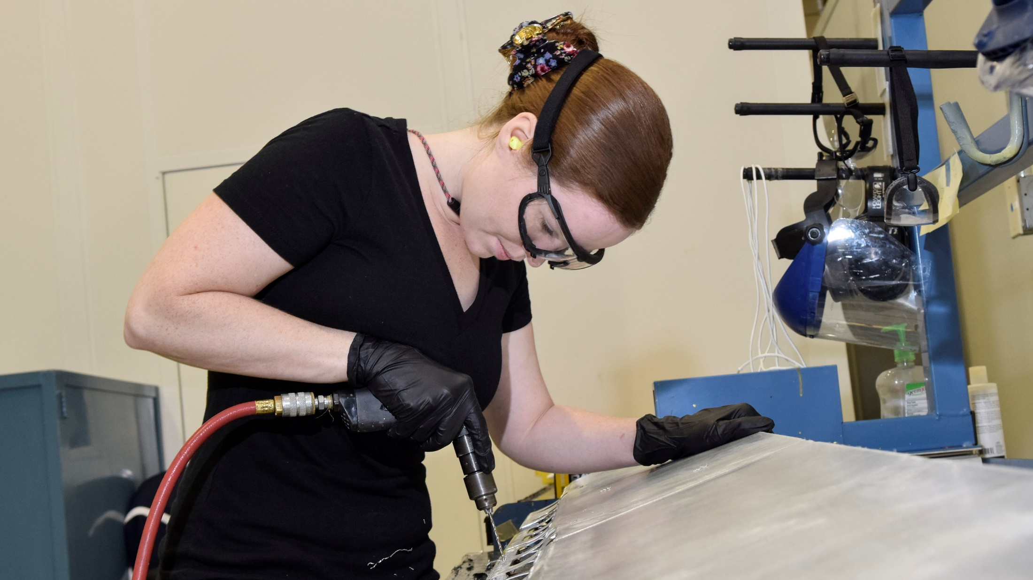
5 Business Models…
Notes:
Taking the Accenture Model Further, we are going to briefly define each of the 5 business models in more detail and provide an example project / enterprise for each.

Slide 14
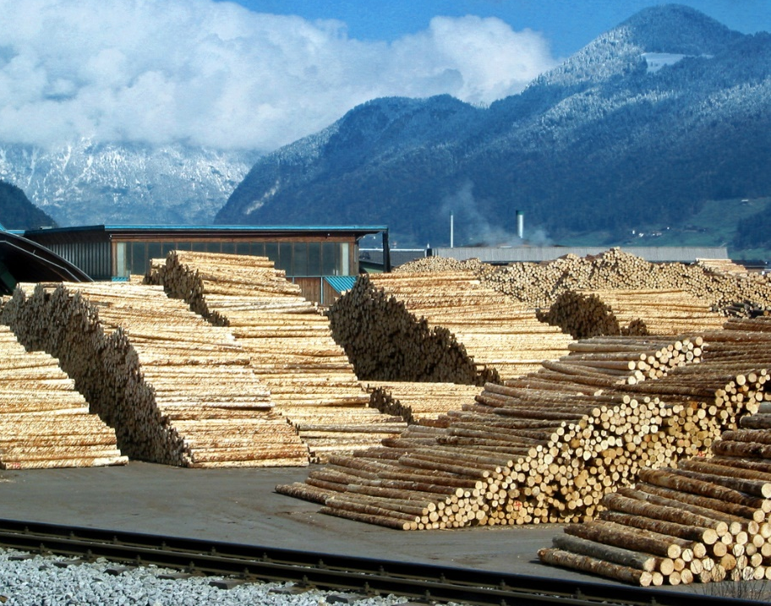
5 Business Models
1. Circular Supplies
In order to survive in a Circular Economy, companies will need phase out the use of finite resources while reducing waste generally.
Circular Supplies businesses would be concerned with the supply of fully renewable, recyclable or biodegradable resource inputs to power or provide for a circular economy.
Land restoration is a further aspect; saving virgin land and looking to build on brownfield sites.
Circular Economy
and the Construction Sector
Notes:
1. Circular Supplies
There are numerous companies globally who deal with finite raw materials, or resources with a detrimental environmental impact. These companies will be at risk in a Circular Economy.
In order to survive, companies will need phase out the use of finite resources while reducing waste generally.
Circular Supplies businesses would be concerned with the supply of fully renewable, recyclable or biodegradable resource inputs to power or provide for a circular economy.
Companies will need to work with their customers and suppliers to specify renewable resources and recyclable material input within the supply chain. They will also be concerned with marketing these products to improve consumer confidence in second-life components or products. This will rely on the design and production of high-quality second life products.
Land restoration is a further aspect; saving virgin land and looking to build on brownfield sites.

Slide 15
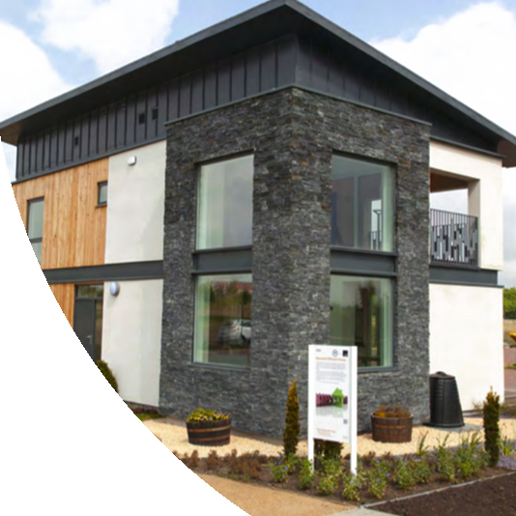
Case Study
1. Circular Supplies
Resource Efficient House, Motherwell:
The house was built on previously contaminated land, once home to a steelworks.
A grey water recovery system was fitted to collect and reuse water from the bath and shower.
Biomass boiler to provide thermal space heating.
Solar Panels for micro power generation.
Designed for deconstruction
Circular Economy
and the Construction Sector
Notes:
CASE STUDY:
1. Circular Supplies
Resource Efficient 3 Bedroom House, Motherwell
A multi-award winning project led by Zero Waste Scotland in partnership with Tigh Grain Ltd (housing developer). Designed by MDM-Architecture. It was constructed to promote and encourage the construction and uptake of affordable, circular, family-homes.
The house was built on previously contaminated land, once home to a steelworks.
A grey water recovery system was fitted to collect and reuse water from the bath and shower.
Biomass boiler to provide thermal space heating
Offsite prefabrication (Modular Build) with structural insulated panels and solar panels. (herness sun’s energy +conserves energy)
Designed with consideration for life cycle (deconstruction, reuse and recycling of the parts); this helps to reduce the resources and energy required for the deconstruction process and ensures preservation of materials for reuse where possible. This helps to reduce embodied carbon.
The house is now open to view for the public / students. This may make for a very valid study trip within certain units we teach. Visits can be arranged by contacting BRE on:
T 01698 262 193 E ravenscraig@bre.co.uk
Travelling by road The BRE Innovation Park at Ravenscraig is built on a new development, not yet recognized by navigation systems. Putting the address into Google maps shows the wrong location. Alternatives are to enter ‘New Craig Road’ or to use the postcode for the nearby Ravenscraig Sports Centre, ML1 2TZ
Travelling by rail or bus Trains to Motherwell station. Bus links are available from there. Contact Strathclyde Passenger Transport on 0141 332 6811 or visit www.spt.co.uk for more information.

Slide 16
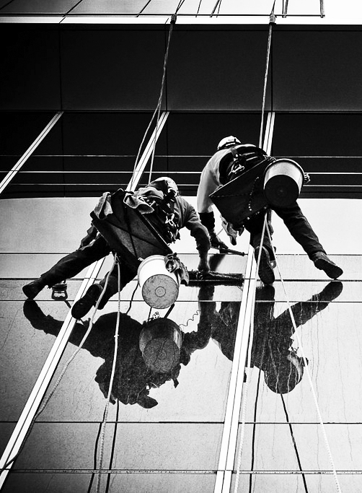
5 Business Models
2. Products as Services
Construction Companies are increasingly offering additional services, like asset management / maintenance.
This involves offering building products, or complete buildings, as outcomes or services rather than assets that the client owns.
Much like music streaming or car leasing, this approach is based on the customer agreeing a continual income stream to the provider, in exchange for the upkeep of an agreed quality.
It incentivises high-quality and waste reduction.
Circular Economy
and the Construction Sector
Notes:
Leasing Building Products as Services
Construction Companies that are looking to expand and enhance revenue, are beginning to look at offering additional services, like asset management / maintenance.
The logical progression of this involves offering building products, or complete buildings, as outcomes or services rather than assets that the client owns.
Much like music streaming or car leasing, this approach is based on the customer agreeing a continual income stream to the provider, in exchange for the upkeep of an agreed quality.
This approach incentivises quality and waste reduction. Companies stand to get enhanced revenue, better margins, sustainable business growth, predictable income streams and higher levels of customer satisfaction. Customers buy a ‘subscription’ to a building and in turn are offered a guaranteed level of quality. The provider is encouraged to optimise the quality of workmanship and value of materials in order to reduce the maintenance burden over the long-term and maximise the value of their service.
Link: https://www.raconteur.net/business-innovation/servitisation-in-construction

Slide 17
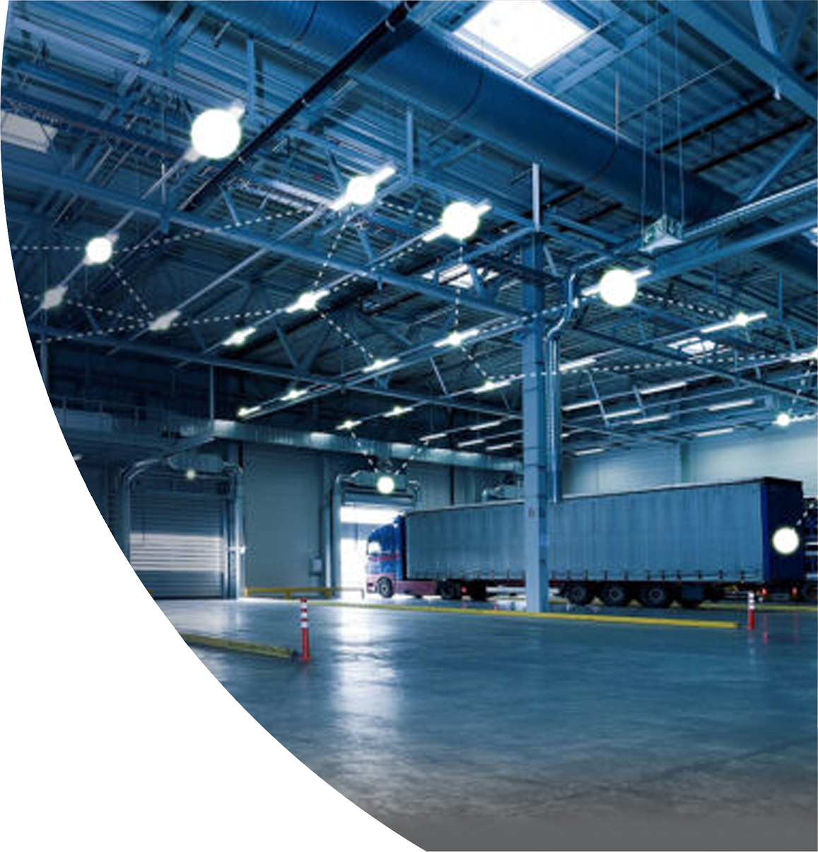
Case Study
2. Products as Services
EGG Lighting, Glasgow:
EGG have developed a ‘Light as a Service’ model, whereby they will retain ownership of light fittings whilst upgrading them as required for customers over the duration of their contract.
EGG have recognised that only 5% of an LED light fitting needs to be replaced when the light breaks. They are developing upgradable light fittings that allows the remaining 95% of the fitting to be retained.
Circular Economy
and the Construction Sector
Notes:
2. Products as Services
EGG Lighting, Glasgow:
EGG have developed a ‘Light as a Service’ model, whereby they will retain ownership of light fittings whilst upgrading them as required for customers over the duration of their contract.
Such practice will help to drive up quality for the customer e.g it is in the interests of EGG to optimise the quality of their service / product to reduce the resources required for maintenance.
EGG have recognised that only 5% of an LED light fitting needs to be replaced when the light breaks. They are developing upgradable light fittings that allows the remaining 95% of the fitting to be retained.
This will help to reduce waste e.g where 95% of a fitting would previously have been unnecessarily discarded when a light breaks, it will now be fully utilised.
Embodied Carbon levels are relatively low, as relatively few new raw materials are required throughout the service lifespan.
https://www.egglighting.com

Slide 18
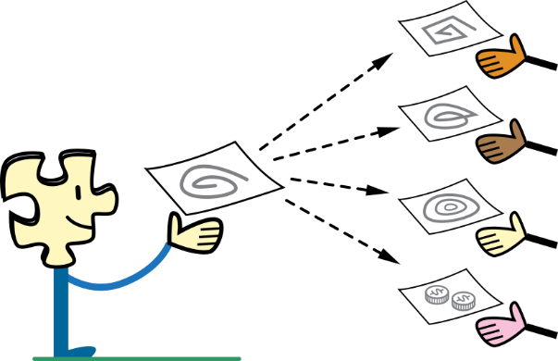
5 Business Models
3. Sharing Platforms
The advent of Social Media has made Asset Sharing an inevitable next step across all sectors.
In Construction, a Sharing Platform can be used to share overcapacity of equipment, services and personnel.
Companies can sign up to a peer-to-peer platform and advertise underused materials or services, which can then be sold or shared with others, benefitting all parties and reducing waste.
Circular Economy
and the Construction Sector
Notes:
Sharing Platforms
The advent of Social Media has made Asset Sharing an inevitable next step across all sectors. The speed with which live information can be updated and shared provides Contractors with an opportunity.
In Construction, a Sharing Platform can be used to share overcapacity of equipment, services and personnel. Labour, Plant or Materials can be advertised as available, where there is excess or underuse, to be shared with other contracting firms. These excess services could be exchanged or simply purchased. Thus overcapacity becomes an asset and not waste.
Companies can sign up to a peer-to-peer platform for a small subscription charge and advertise underused materials or services. These can then be sold or shared with others, benefitting all parties and reducing waste.
FLOOW 2 is an example of this, which covers many sectors (https://www.ellenmacarthurfoundation.org/case-studies/business-to-business-asset-sharing)

Slide 19
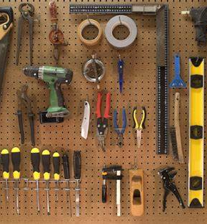

Case Study
3. Sharing Platforms
Globechain
With over 10,000 members, Globechain provides an online re-use platform that connects businesses, charities and people to enable them share and re-use unwanted items within a global supply chain network.
This includes construction tools and equipment.
Circular Economy
and the Construction Sector
Notes:
If you consider the demand for construction tools and equipment, this system flips the the focus of this demand, from buying new to buying perfectly good second hand items. This reduces waste considerably, and thus reduces embodied carbon.

Slide 20
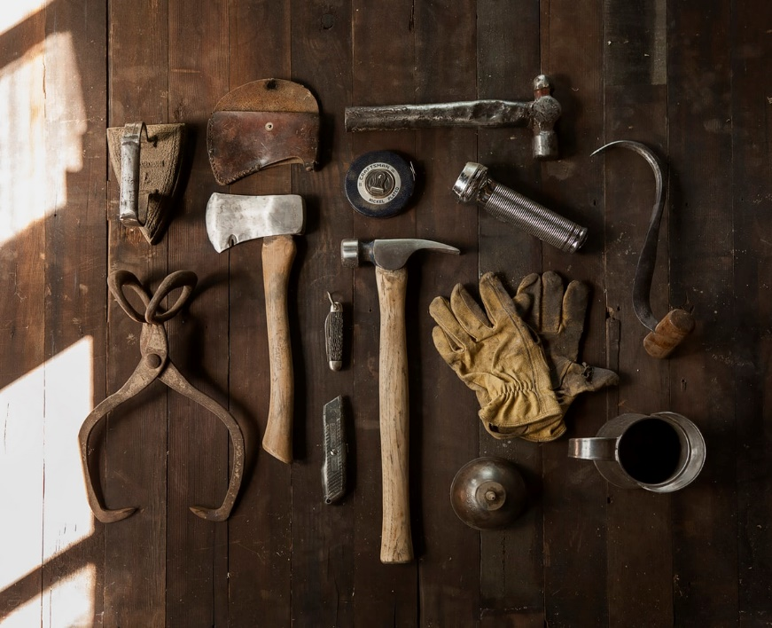
5 Business Models
4. Product Life Extension
The life of a product can be prolonged through repair and careful maintenance, but does this always promote optimum value?
Within a Circular Economy, products should be designed to ensure that repair, upgrading and remanufacturing are straightforward and entirely feasible. Why replace an entire product when just one component is at fault?
Businesses would thrive who could offer component upgrades rather than entire product replacements.
Circular Economy
and the Construction Sector
Notes:
4. Product Life Extension
The life of a product can be prolonged through repair and careful maintenance, even within the Linear Economy model. But this does not promote the optimum resource value.
Within a Circular Economy, products should be designed to ensure that repair, upgrading and remanufacturing are entirely feasible. Why replace an entire product when just one component is at fault?
Businesses would thrive who could offer individual component upgrades as part of their service rather than entire product replacements, or to remanufacture and market products of equivalent or superior value to the original.

Slide 21
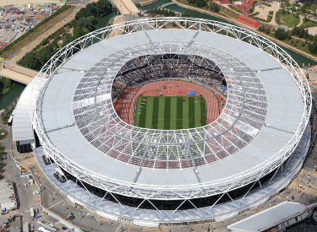
Case Study
4. Product Life Extension
Queen Elizabeth Olympic Park, London
Most of the components were constructed offsite with mechanical fixings to allow for deconstruction and ease of maintenance / reuse.
Buildings were designed to be temporary, so they could be removed and re-used after the Games.
Two reused construction logistics bridges have been repurposed following the completion of the Games.
Circular Economy
and the Construction Sector
Notes:
4. Product Life Extension
Queen Elizabeth Olympic Park, London
The component parts / buildings for the Olympic park were designed for ease of maintenance , adaptation and dis-assembly / reuse.
Most of the components were constructed offsite with mechanical fixings to allow for deconstruction and ease of maintenance / reuse.
Buildings were designed to be temporary, so they could be removed and re-used after the Games.
The Basketball Arena was built from several components that could be easily disassembled and re-assembled in new locations
Two reused construction logistics bridges have been repurposed following the completion of the Games.

Slide 22
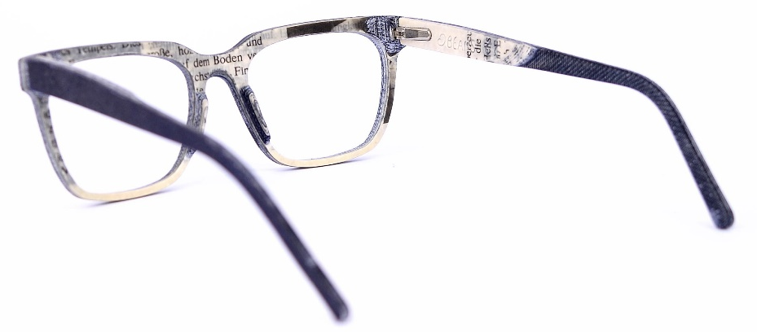
5 Business Models
5. Resource Recovery
This concept has much in common with previous solutions such as ‘Industrial Symbiosis’ and ‘Cradle-to-Cradle’.
It focusses on recovering the optimum value of a product at the end of it’s lifecycle. Innovative recycling or remanufacturing businesses will flourish.
It may also be useful for businesses who already create a large volume of waste to expand their current service and reprocess the waste generated to become an asset.
Circular Economy
and the Construction Sector
Notes:
5. Resource Recovery
Given the forecasted scarcity of new raw materials, being able to extract raw materials from existing products before they become waste would appear to be a business model that will thrive under a circular economy.
Resource Recovery as a concept has much in common with previous solutions such as ‘Industrial Symbiosis’ and ‘Cradle-to-Cradle’.
Where waste occurs, it focusses on recovering the optimum value of a product at the end of it’s lifecycle. Innovative recycling or remanufacturing businesses can flourish where they are able to identify and extract a value in a waste product, and build a business around this.
It may also be useful for existing companies who already create a large volume of waste, to expand their current service and reprocess the waste generated to become an asset.
The notion of ‘Upcycling’ also exists here.

Slide 23
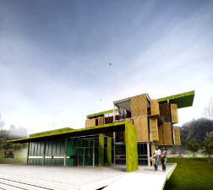
Case Study
5. Resource Recovery
Buildings as Material Banks (BAMB)
Buildings should be designed to maximise reuse potential.
If buildings are designed for products or materials to be reused at the end of it’s life, the value of that building as an asset increases.
Business opportunities then arise; who manages or owns the material data, downtakings & distribution?
Circular Economy
and the Construction Sector
Notes:
BAMB is an EU funded initiative that begins with the notion that buildings should be designed to maximise reuse potential.
If buildings are designed for products or materials to be reused at the end of it’s life, the value of that building as an asset increases.
Business opportunities then arise from this concept; who manages or owns the material data, downtakings & distribution? These provide opportunities for new businesses to grow around the concept of Buildings as Material Banks.
Increased digitisation within the construction sector has enabled this way of thinking. BIM software, for example allows every detail of a building to be part of a live inventory. Material Passports, as discussed earlier, where each component in a building becomes traceable and actively recorded, allows a building to be a constantly updating catalogue of materials or components, with a re-sale value following replacement or demolition. This video explains the idea of Material Passportsin relation to BAMB - https://www.bamb2020.eu/topics/materials-passports/
The BAMB concept aims to influence the way we approach design and construction at a Micro level, as well as Macro. This may include simple techniques like not using adhesive fixings where mechanical can be used, to allow greater ease and preservation in the dismantling process. Or keeping services, which may need to be replaced, in skirtings with easy access, not behind plasterboard that would not need to be replaced so readily.
This ultimately results in waste reduction, value retention and the use of fewer virgin materials. In it’s essence it considers the whole building and building component lifespan, reducing embodied energy.

Slide 24
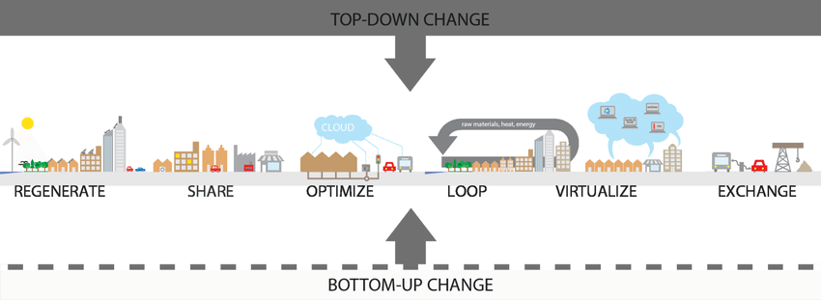
Additional School of Thought…
ReSOLVE Model
Circular Economy
and the Construction Sector
Notes:
There are other models / schools of thought such as the ReSOLVE model, which compliment the Accenture Model.
Additional:
ReSOLVE provides learners with a 6-point rules-of-thumb introduction to the principles of a Circular Economy, beyond just the Construction Industry:
Regenerate: Shift to renewable energy and materials,
Reclaim, retain, and restore health of ecosystems
Return recovered biological resources to the biosphere
Share: Share assets (eg.cars, rooms and appliances)
Consider secondhand / reuse
Prolong life through maintenance, design for durability / upgradability
Optimise: Increase / optimise performance
Remove waste in production and supply chain
Loop: Remanufacture products
Recycle materials
Digest waste anaerobically to return to the biosphere
Virtualise: Dematerialise directly (e.g books, CDs, DVDs, travel)
Dematerialise indirectly (eg. online shopping)
Exchange: Replace old with advanced non-renewable materials
Apply new technologies (eg. 3D printing)
Choose new product / service (eg. Multimodal transport)
For example, The Ellen Macarthur Foundation has a number of great resources online (https://www.ellenmacarthurfoundation.org)

Slide 25
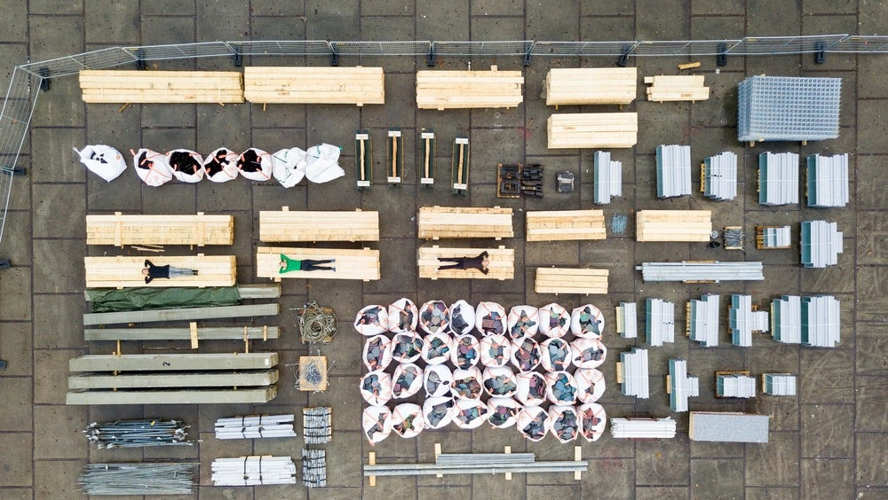
Notes:
We are now at the end of the slideshow sessions, introducing the concept of the Circular Economy.
I will bring this part of a session to a close by showing this image again and highlighting the idea that within the Circular Economy, this may be a building at the beginning or the end of it’s life. Constructed and dismantled carefully and considerately.

Slide 26
Session 3
Rethinking Business Models in Construction
Schools of Thought
Accenture Model
Five Business Models + Case Studies
Circular Economy
and the Construction Sector
Notes:
A brief reminder of what was covered in Session 3.

