Slide 1




Circular Economy
& the Construction
Sector

Slide 2

Workshop 2 – Procurement and Site Waste Management Plans
The benefits of reduce, reuse, recycle
Higher standards of performance - While not mandatory, some clients and planning authorities promote the value of sustainable construction initiatives such as BREEAM
Financial - Landfilling waste can cost over £100 per tonne
Good management practices – any development paying attention to waste management is likely to be managing all other aspects of the business well
nitiatives recognise the importance of Benefits
Breeam
Code for Sustainable housing
Evidence of savings
What it is
Notes:
What are the incentives for minimising construction waste.
Some developments and clients look for sustainability built in. BREEAM is one such standard where effective waste management is a requirement.
There has been a financial incentive in place for some years, with the cost of landfilling waste costing as much as £100 per tonne. Even recycling can be as expensive due to the costs of reprocessing

Slide 3
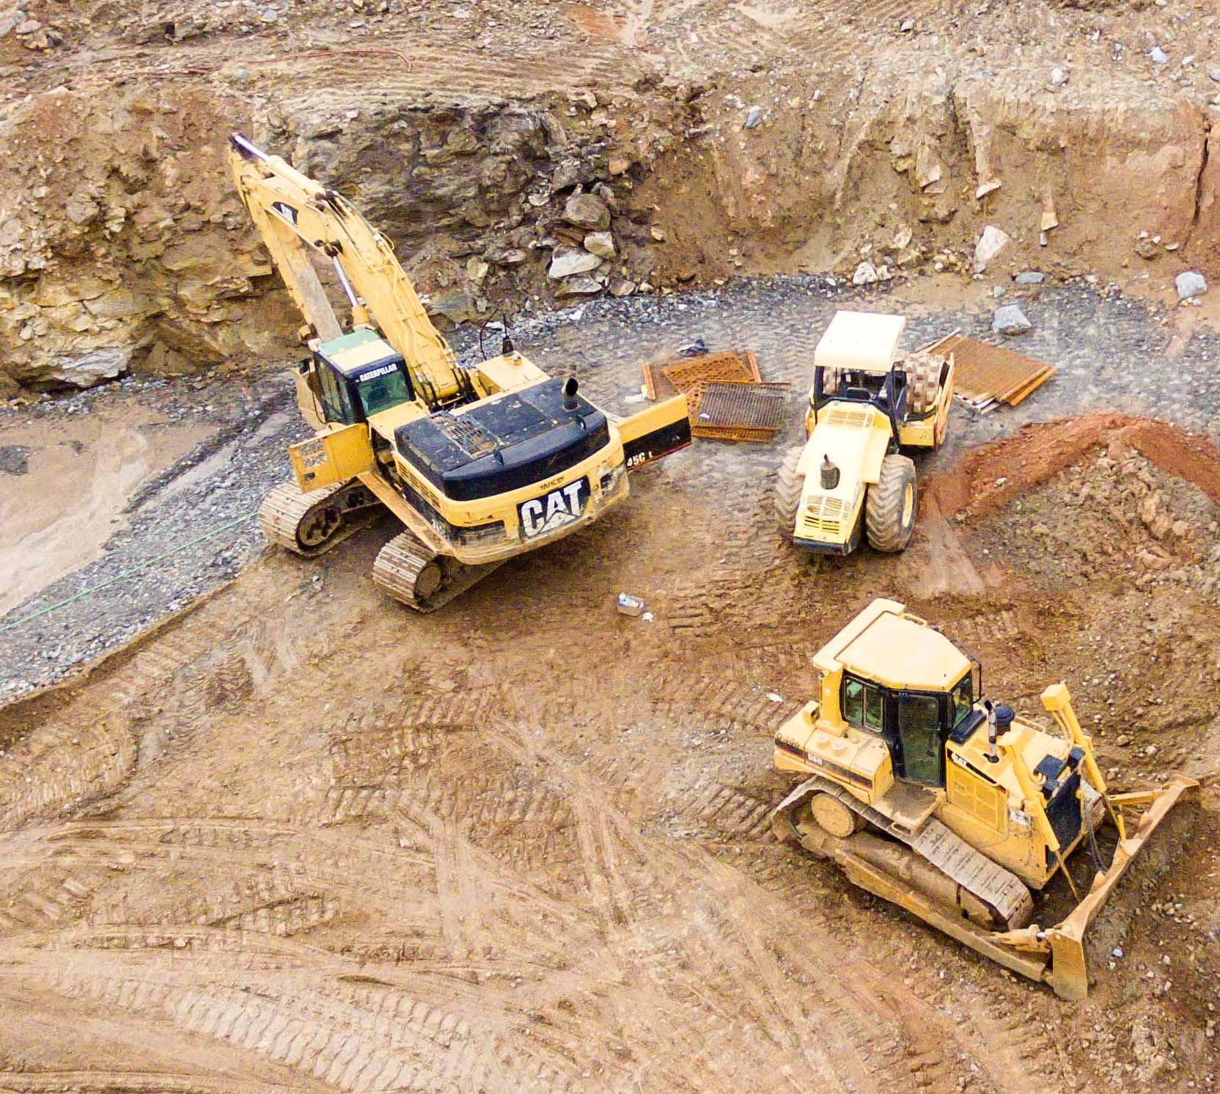
Introduction
This Workshop looks at two tools that can be used to promote reduce, reuse, recycle on the construction site:
Procurement – occurs early in the contract at a time when a clients requirements are set out – an opportunity to build in environmental performance requirements
Site Waste Management Plans – A documented approach to measuring and reporting on waste movement throughout the build.

Slide 4


Procurement
Procurement – or working with the supply chain – is one of the key Circular Economy business models identified by Accenture.
an opportunity to drive waste management performance
occurs early in the project
often a one-off opportunity
Set Key Performance Indicators (KPIs) that can be incorporated into the contract
Task – In your group, set out what requirements or types of KPIs you might use in a tender document
Notes:
Procurement is a major topic in itself with specialist who prepare tender briefs and documents. However, it possible to express waste management related requirements in such documents – and is worth doing because it presents a unique opportunity to drive through improved waste management performance. Once contracts are signed, t becomes very difficult to make subsequent changes or requirements.
It also remains important to be able to measure compliance with the requirements in some meaningful way. Key Performance Indicators can be used to assess a contractors performance.
Task: In this task what kind of KPIs would be useful to minimise waste in the build
KPIs have to be clearly defined and unambiguous. So explore the responses the students provide. The kind of KPIs we are looking for is on the next slide but are generally:
% of waste that is diverted from landfill and reuse/recycled. On total amount of waste that is generated. It might also be used to separate out soils and inert materials from construction based materials.

Slide 5

Possible Procurement KPIs
Require the contractor to operate an environmental management system, operate a site waste management plan during the life of the project
Require the contractor to report:
% of construction waste produced that is diverted from landfill and is recycled – evidenced by waste contractors
% of material use onsite that is made from recycled content.
Total amount of waste (tonnes) generated by type.

Slide 6

Procurement Guidance
Notes:
There is also good guidance provided by Resurce Efficient Scotland to support emebedding waste and environmental performance conditions. Check out Resource Efficient Scotland’s website

Slide 7

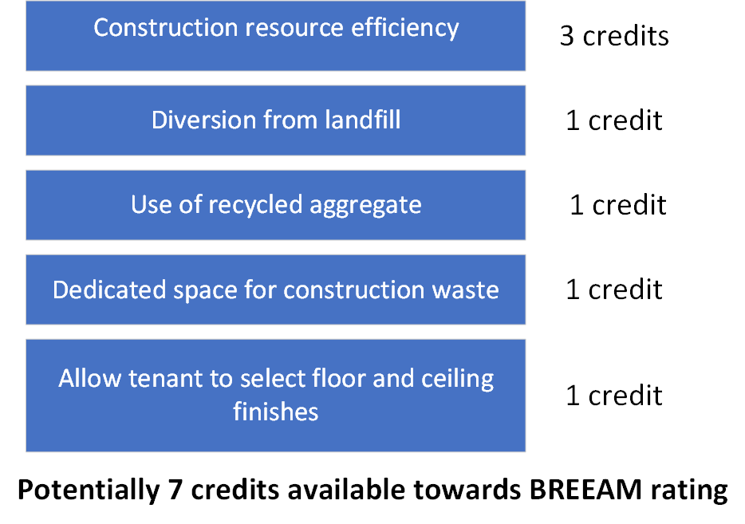
BREEAM
A sustainability assessment for buildings, recognising value in higher performing assets
Waste Management is 1 of 9 issues which needs to be considered in the scoring – which could be the difference between “Good” and “Very Good”
The Code for Sustainable Homes has ended – but had waste management requirements that aligned with circular construction

Slide 8

Measure to Manage
Task – What kind of documentary evidence could we produce on a site that would allow us to demonstrate steps are being taken to reduce, reuse, recycle?
Notes:
So we are looking for the students to consider what kind of information that a contractor could provide to offer evidence of waste reduction or waste reuse/recycling performance.
In this section we are looking for the students to offer up the need to have a systematic plan and reporting system that is maintained during the project life cycle.

Slide 9
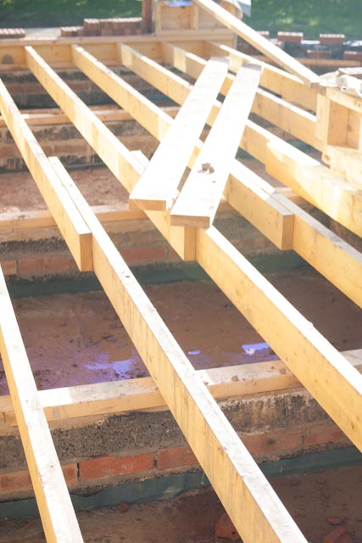
Site Waste Management Plans
Introduced to address concerns over flytipping – Duty of Care
SWMP become more complex and for a time legal requirement in England.
Record the amount of waste being generated
Materials
Tonnages
Costs
Recovery rates (reuse/recycled)
Notes:
Site Waste Management Plans were introduced in 2006, principally to address concerns over duty of care. Duty of Care places a responsibility on producers of waste to ensure that any contractors or third party mange the waste properly. The introduction of a landfill tax led to increased flytipping and SWMPs were a mechanism to help contractors check their waste contractors were properly licensed.
For some time they were a legal requirement for any development over £350k in England, but are now a purely voluntary measure – but still considered good practice in major developments.

Slide 10
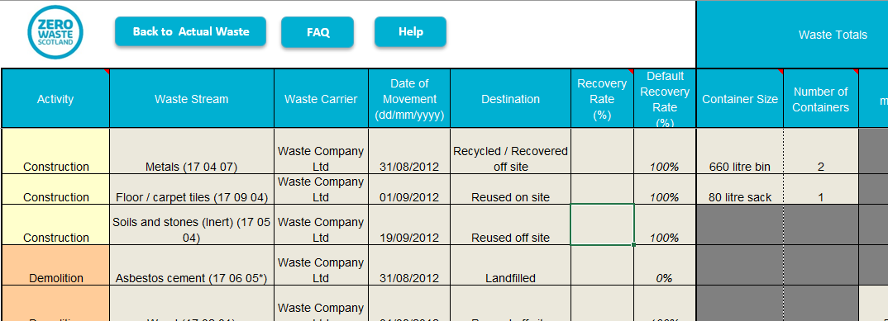
Site Waste Management Plans
Zero Waste Scotland makes available a SWMP Lite tool
Excel based
BRE has also produce web-based Smart Waste
Notes:
Site Waste Management Plans were introduced in 2006, principally to address concerns over duty of care. Duty of Care places a responsibility on producers of waste to ensure that any contractors or third party ensure their waste who

Slide 11
Site Waste Management Plans
Task: Who is best placed to managed the SWMP and who needs to supply information to main the records

Slide 12

Conclusion
Early intervention and planning will help all stakeholders engage in waste reduction
Procurement – contract conditions, clearly defined, allow targets to be set and reported
Site Waste Management Plans provide the reporting structure to measure waste performance across the site.

