Slide 1




Circular Economy
& the Construction
Sector

Slide 2

Workshop 3b – Innovation and the
Circular Economy
This Workshop is part of a group of three short workshops which highlight three areas of innovation in the construction sector that offers the additional benefit of making the sector more circular. The three areas are:
Modular Design and Build
Building Information Management
Refurbishment and Building Layers
Circular Economy
and the Construction Sector
Notes:
This workshop is brings together 3 new areas of innovation for the construction sector that are relevant to the implementation of a circular economy. These concepts are highly innovative and are likely to bring about significant change to the construction sector not just in relation to waste management and resource efficiency but also in the broader efficiency and delivery of construction projects.
They are
modular design and build
building information management or BIM and
Scope for greater refurbishment and viewing buildings as layers with different time frames.
This workshop focusses on Building Information Management and the greater use of IT to disseminate and share information concerning a construction project.

Slide 3
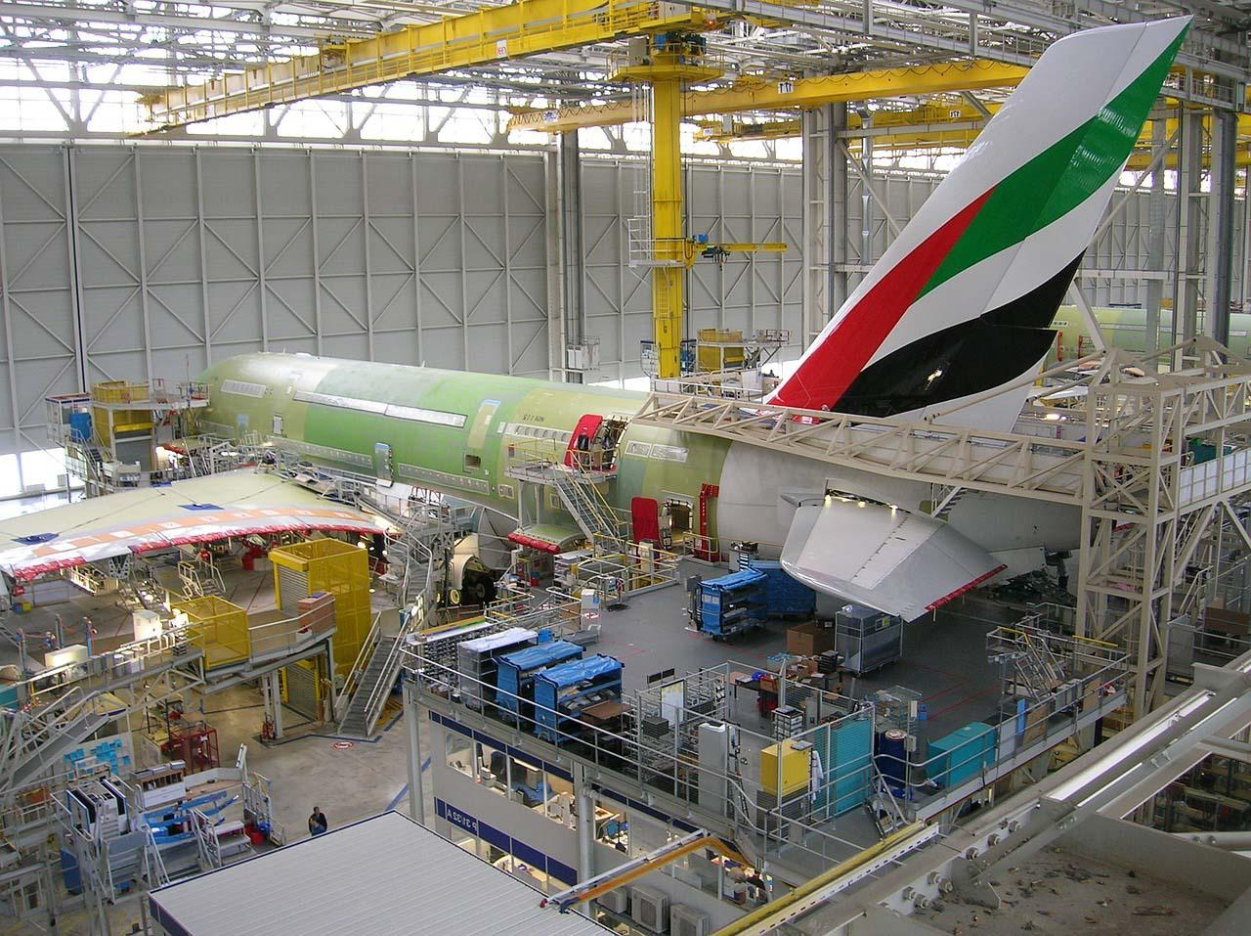
Innovation and the
Circular Economy
The construction sector is conservative, where innovation has been slow over the past 20 years. Contrast developments in the manufacturing sector.
Task: Before starting this workshop think why has the sector been slow to innovate and develop new ways of working
Circular Economy
and the Construction Sector
Notes:
There's a reasonable case to make that the construction sector has not been the most innovative of industries over the past 20 years. Contrast that with the manufacturing sector, such as car manufacture or aircraft build.
So it’s worth considering why this should be so before starting the workshop. Let's give some thought to why the sector has been slow to innovate, embrace technology and apply new ways of working.
At this point give the students the opportunity to think this through. There will be a number of reasons for this.
One might be that the sector operates on site and little scope for automation or standardisation.
Another is the that the sector is very labour intensive sector and the opportunity to improve this
A third reason might be the way the sector operates with different stakeholders with different areas of responsibility, and as we have seen, often the planning, design and build process is inhibited by the relationships between the different stakeholders.
So lets look at some of the innovation practices that are taking place – that may have an impact on the extend to which the sector can become circular.

Slide 4
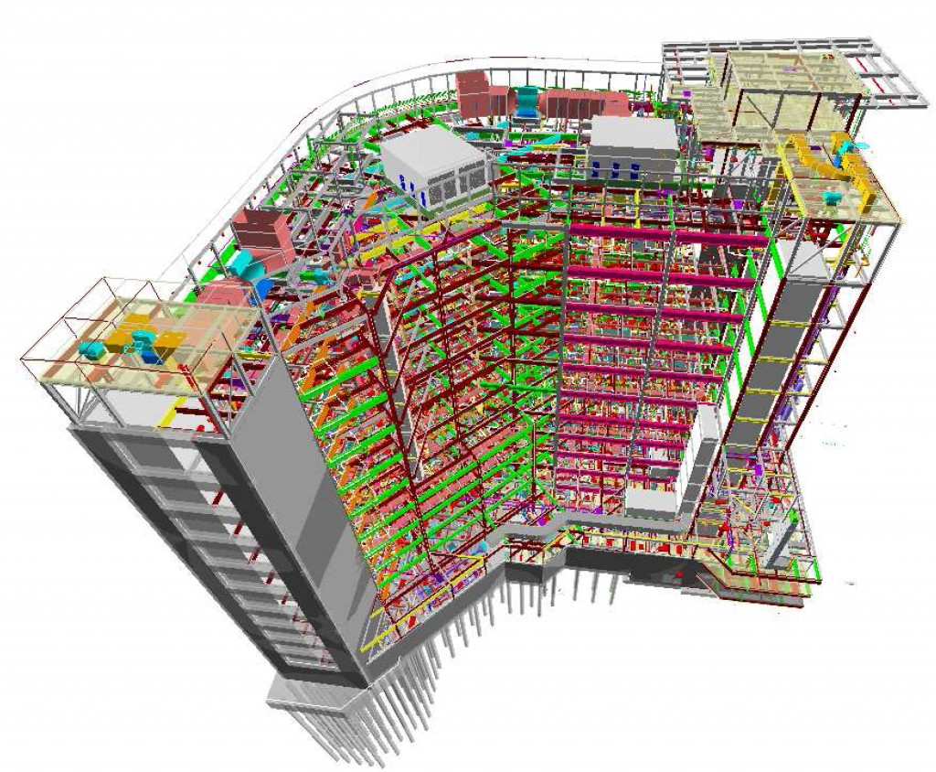
Building Information Modelling
BIM is a collaborative computer modelling technology which replaces traditional CAD draughting tools.
Designs are built and shared across all disciplines from Design to Construction.
Real-time access to design and work progression for all stakeholders.
Notes:
BIM is a collaborative form of building design, used to its fullest extent every stakeholder involved in a project will be able to view and edit the model. BIM involves the generation or digital data which describes the physical characteristics of the building or structure this information can be used throughout the project by different stakeholders for different purposes. It addresses one aspect of the circular economy and construction in that information about the bill can be shared bye everyone and therefore reducing the scope for errors due to design changes for example.
BIM is heralded as the next progression in building modelling from CAD drawings.

Slide 5
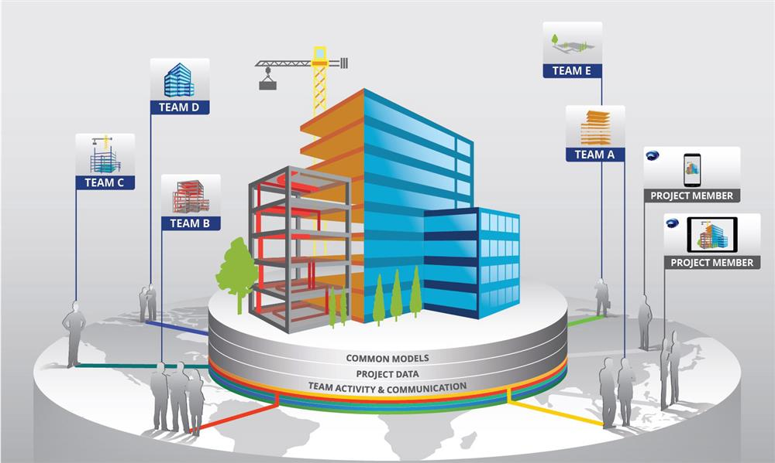
Building Information Modelling
Enhanced communication between all stakeholders.
Improved visualisation.
Encapsulates the entire lifecycle of a project (Inception – Use – End of Life).
Can provide a materials inventory of project.
Notes:
BIM seeks to enhance collaboration between disciplines involved in draughting a building design and provide a single shared model as opposed to multiple discrete models used by Architects, Engineers etc.
In this section we're not going to explain BIM in any detail. It is still an evolving area of technology with many different proprietary systems being offered. Here we focus on the benefits that BIM can bring to a circular construction sector.
We already mentioned better communication between stakeholders
Improved visualization will assist clients and designers in the design and development of the project it can encapsulate the whole life cycle of a project through to end of life
the potential to provide an inventory of all material within the build at the end of life.

Slide 6
Workshop Task 1
In small groups discuss and separate the terms in the list providing under the headings if Building Information Modelling and Traditional CAD.
Files held on a shared data base.
Must be used in all public sector construction under UK mandate.
Wealth of industry experts.
Low initial investment.
High initial investment.
Stakeholders have constant access to the project model.
Allows design on HVAC and Electrical systems.
Draughts must be sent to stakeholders for approval.
Allows for greater communication between disciplines.
Industry standard for 20+ years.
Files stored discretely by the designers.
Notes:
The purpose of this task is to highlight the differences between BIM and CAD.
BIM is the natural evolution of construction modelling in the same vein as CAD is the natural progression from paper and clay models.

Slide 7
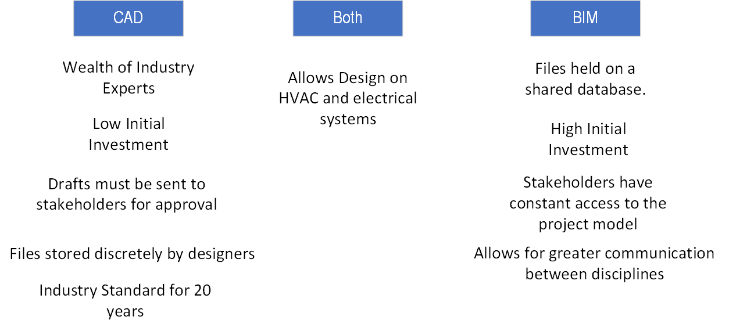
Workshop Task 1
Notes:
The purpose of this task is to highlight the differences between BIM and CAD.

Slide 8
Why Use BIM?
Better communication and smoother coordination makes for less conflict in design stages.
Transparency and greater capacity for visualisation allows all stakeholders to stay informed and up to date.
Greater levels (levels 1,2,3+) and dimensions (3D, 4D, 5D+) to BIM can develop considerations for procurement, construction, end of life and the health and well-being of the surrounding community.
Notes:
Better communication translates to fewer inconsistencies in the design phase, this saves time and money.
Clients are able to view much more detailed models through BIM, Virtual tours of buildings are even possible by combining BIM models and Virtual Reality.
Levels of BIM are defined by the level of collaboration used between disciplines when generating the building model
3D refers to drawings generated, 4D is linked to time management of the project, 5D is concerned with project costs, 6D is dedicated to the life cycle management of a building

Slide 9
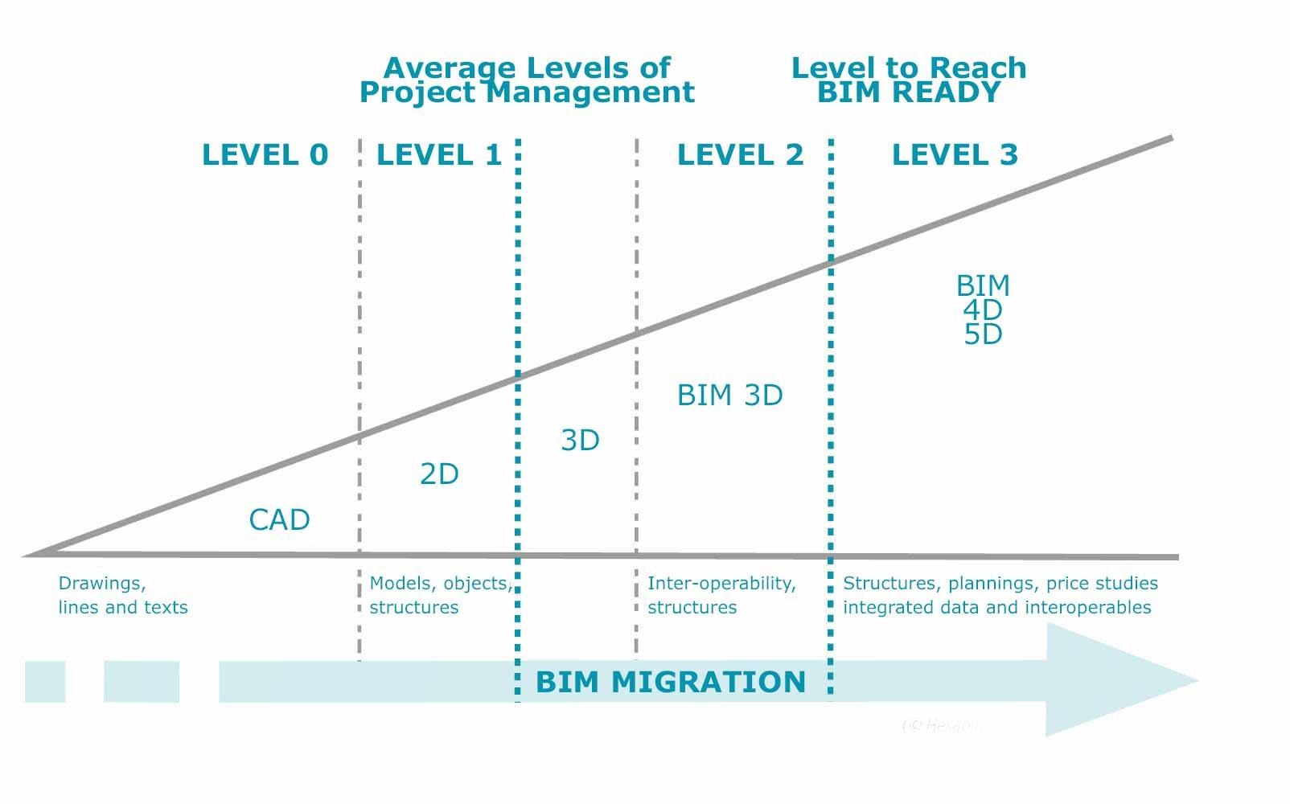
BIM Levels
BIM maturity is defined through levels.
The level defines the degree of coordination involved in a projects.
Level 0 - No collaboration with basic 2D CAD drawings.
Level 1 - 3D CAD files shared and managed by a single stakeholder.
Level 2 – Several models but collaboration between possible.
Level 3 - Single shared model shared in the cloud.
Check the link https://www.youtube.com/watch?v=mN0IhmMr4WY
Notes:
The boundaries between BIM levels are not universally agreed upon but there is British standards guidance on levels 1 and 2
Levels 1 & 2 - BS 1192:2007 + A2:2016 Collaborative production of architectural, engineering and construction information. Code of practice
Video explanation of BIM maturity levels: https://www.youtube.com/watch?v=mN0IhmMr4WY
Most commonly described using the Bew & Richards diagram shown in the slide.
Level 1 – 3D CAD drawing managed by a single stakeholder this is typically the contractor
Level 2 – All files used in the building model can be exported to a common file format which are brought together at agreed intervals.
Level 3 - Makes use of a fully integrated model that uploaded to a cloud server, accessible for anyone to view, edit and update.

Slide 10
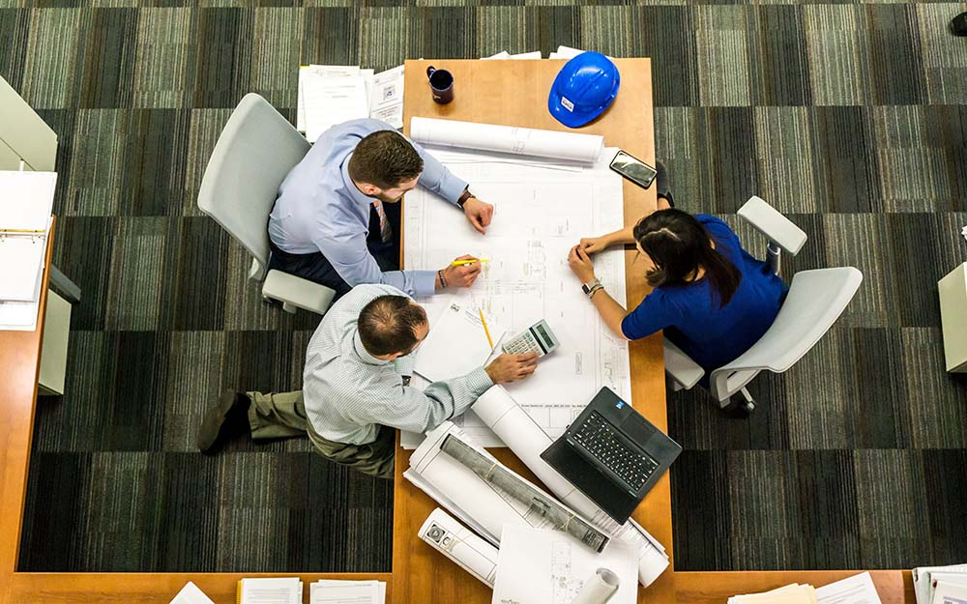
Benefits
BIM saves money by cutting down on clashes in designs before they reach the construction site.
Better visualisation translates to fewer meeting required.
Time is saved through fewer meetings and fewer alterations made onsite.
Waste reduction through clash avoidance.
Notes:
BIM allows for ‘clash detection’ which is the identification of errors and inconsistencies in the projects model, these can them be resolved before they reach the construction site saving time and money by avoided reworking on site. Saving time and money.
This smoother communication is the primary benefit of using BIM but as we continue we see that BIM has more supporting benefits in a circular economy context.

Slide 11
BIM in Circular Economy
BIM models contain associated information for the materials required for a project, this feeds into:
  Procurement decision making.
  Just in time delivery of materials.
  Building maintenance (products as services)
  Design for disassembly.
  Material passports (Building as a Material Bank BAMB).
Notes:
BIM models can contain information on materials required, the precise placement of building services, material shelf-life as well as fixings and building sensors. This information can be given to the client to provide insight into building management and end of life considerations.
The information database generated by a BIM model is able to support various stages of the Circular economy acting as an effective launch pad for further development for companies seeking to enter in to a Circular economy business model.

Slide 12
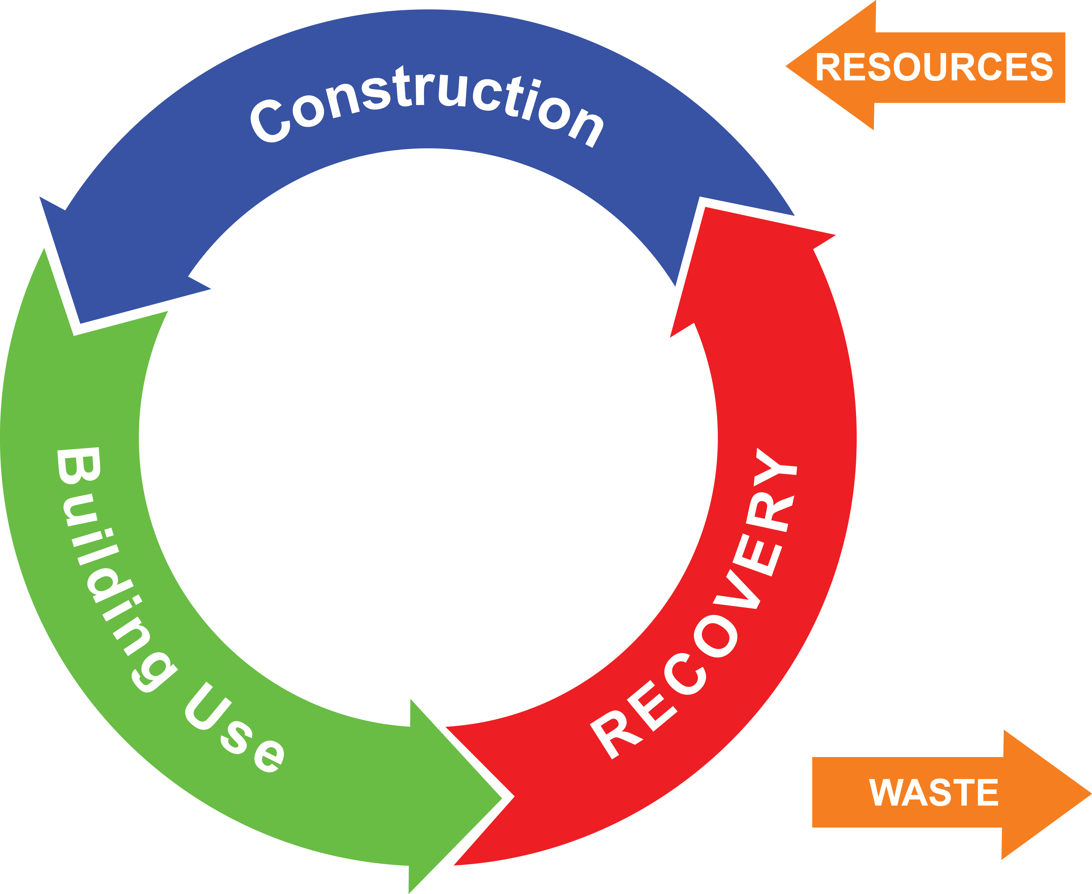
Workshop Task 2
In small groups discuss the circular economy and complete close the loop shown in the worksheet using the list of construction technologies and practices provided.
In what parts do the following fit in supporting circular construction.
Prefabrication
Procurement
BIM
Disassembly
Demolition
Notes:
The purpose of this task is for the groups to create their own circular models of the construction sector using technologies and concepts covered in the previous sections with the driving lesson being that BIM can be incorporated at various stages in the life cycle of the building
Groups should be encouraged to see where each method fits in support of a circular construction sector
Key to note is that BIM fits everywhere:
In the design/construction phase eliminatinga and reducing waste
In the building use through life of the building
And in the recovery/refurbishment/demolition phases where structures and materials can be identified for reuse.

Slide 13
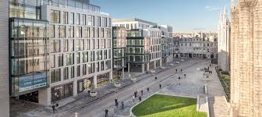
BIM Case Study – Marishal Square, Aberdeen
BIM Level 2 – used scheduling 4D visualisation software
£107m value
Waste reduction estimated to be 30-40% compared to similar sized projects
Hundreds of clashes (potential for waste) avoided
Notes:
It is difficult to find examples or projects which exemplify BIM and at the same time provide information on the amount of waste there has been avoided due to the use of BIM.
One example is a development in Aberdeen where visualization software and BIM level 2 was applied.
It was estimated by the developers that 30-40% reduction in waste was achieved.

Slide 14
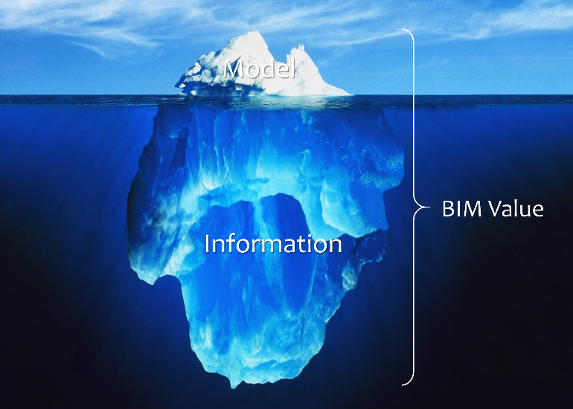
Conclusion
The true value of BIM comes from the data associated with the model rather than the 3D model itself.
Building information modelling is a vital step required to make the circular economy in the built environment possible.
The UK government has mandated that all public sector works in the built environment achieve at least BIM level 2.
Notes:
BIM and the more advanced levels are expected to become more common place. This greater adoption of BIM technology and better visualisation tools, will improve the design and construction process and by doing so, will have the beneficial effect of avoiding mistakes and poor communication that often leads to waste.
At the same time it will allow designers and clients to explore the use of more sustainable materials reduce the embedded energy or carbon footprint of a building.

