Slide 1




Circular Economy
& the Construction
Sector

Slide 2

Workshop 3 – Innovation and the
Circular Economy
This Workshop is part of a group of three short workshops which highlight three areas of innovation in the construction sector that offers the additional benefit of making the sector more circular. The three areas are:
Modular Design and Build
Building Information Management
Refurbishment and Building Layers
Circular Economy
and the Construction Sector
Notes:
This workshop is brings together 3 new areas of innovation for the construction sector that are relevant to the implementation of a circular economy. These concepts are highly innovative and are likely to bring about significant change to the construction sector not just in relation to waste management and resource efficiency but also in the broader efficiency and delivery of construction projects.
They are
modular design and build
building information management or BIM and
Scope for greater refurbishment and viewing buildings as layers with different time frames.
This workshop focusses on refurbishment and how we might begin to think of a construction project as a series of layers, each with their own lifespan.

Slide 3
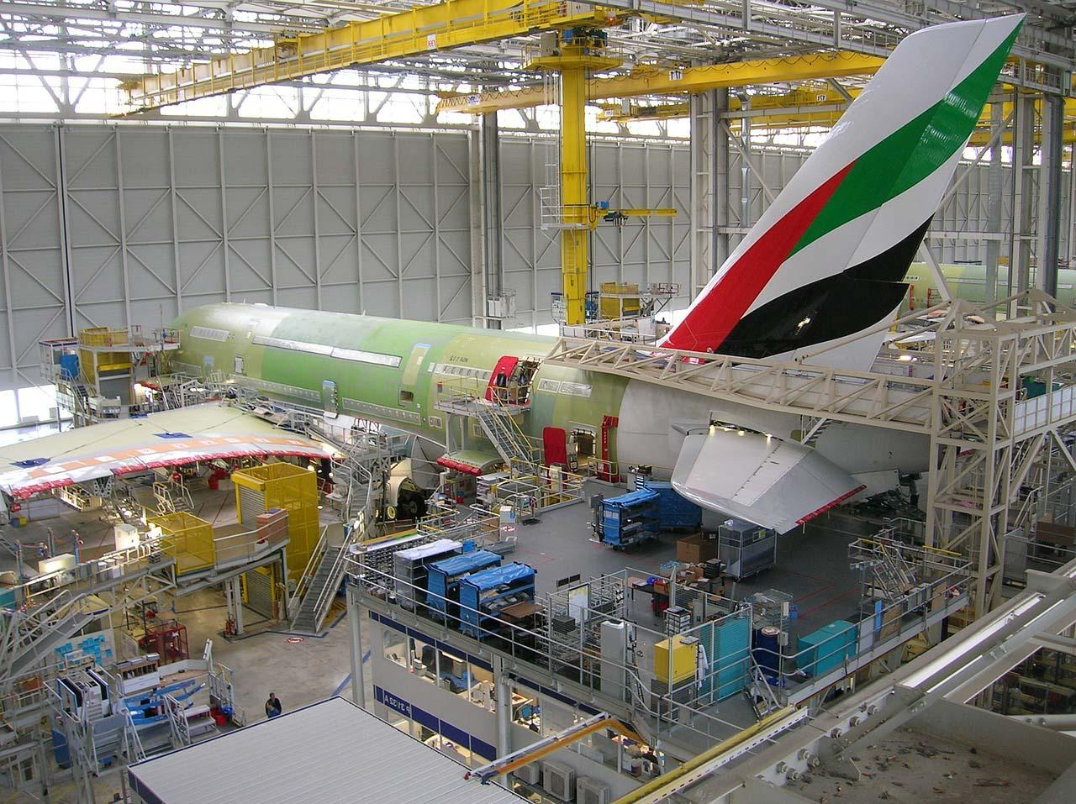
Innovation and the
Circular Economy
The construction sector is conservative, where innovation has been slow over the past 20 years. Contrast developments in the manufacturing sector.
Task: Before starting this workshop think why has the sector been slow to innovate and develop new ways of working
Circular Economy
and the Construction Sector
Notes:
There's a reasonable case to make that the construction sector has not been the most innovative of industries over the past 20 years. Contrast that with the manufacturing sector, such as car manufacture or aircraft build.
So it’s worth considering why this should be so before starting the workshop. Let's give some thought to why the sector has been slow to innovate, embrace technology and apply new ways of working.
At this point give the students the opportunity to think this through. There will be a number of reasons for this.
One might be that the sector operates on site and little scope for automation or standardisation.
Another is the that the sector is very labour intensive sector and the opportunity to improve this
A third reason might be the way the sector operates with different stakeholders with different areas of responsibility, and as we have seen, often the planning, design and build process is inhibited by the relationships between the different stakeholders.
So lets look at some of the innovation practices that are taking place – that may have an impact on the extend to which the sector can become circular.

Slide 4
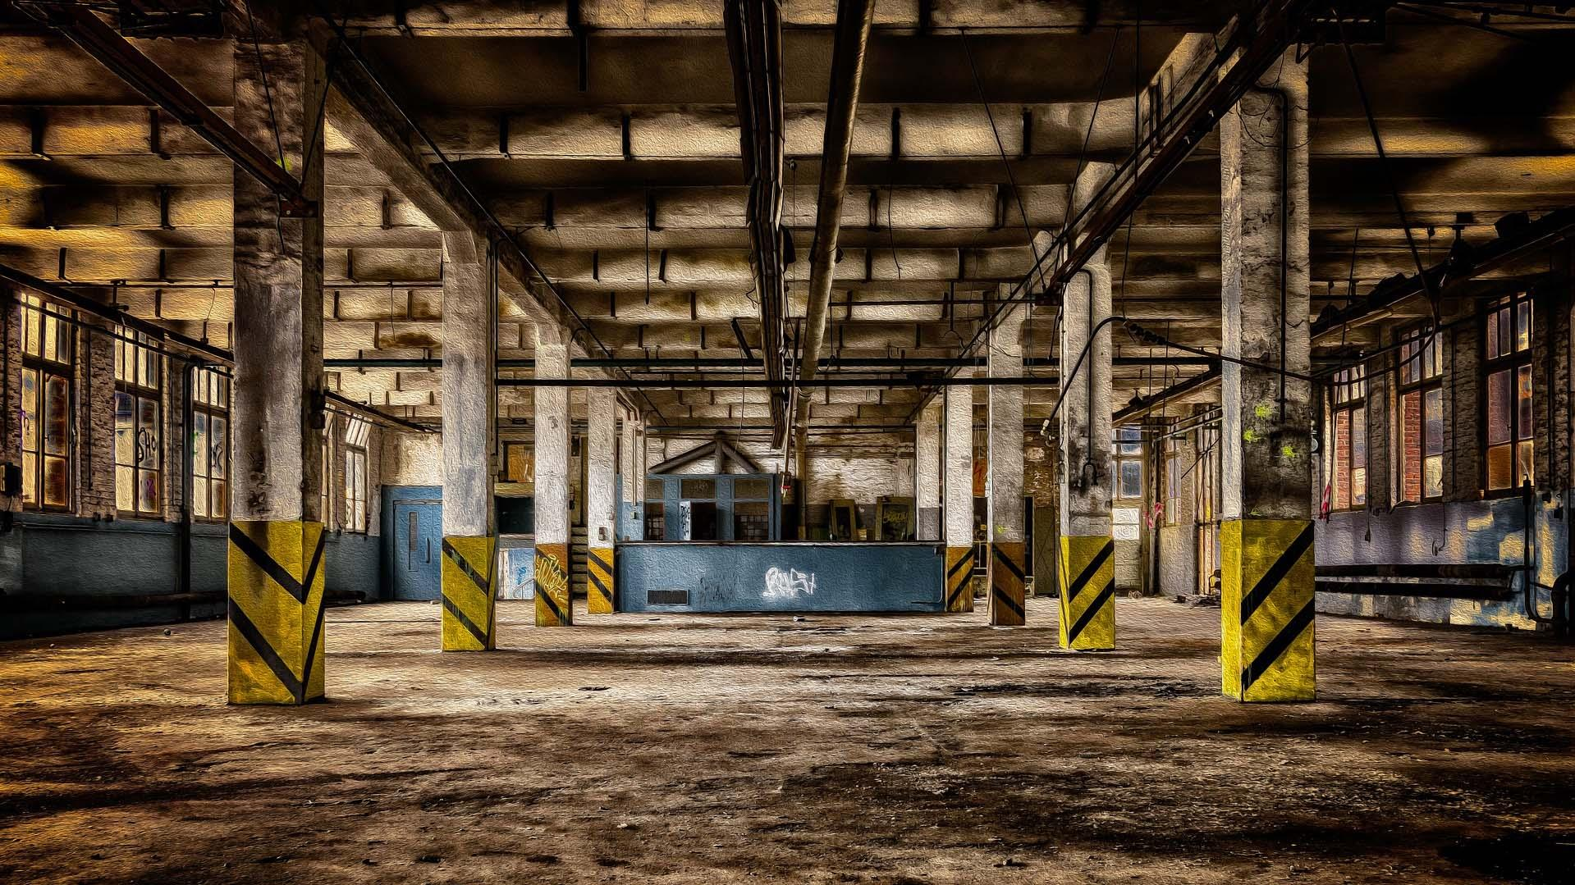
Building Layers
An opportunity for refurbishment

Slide 5
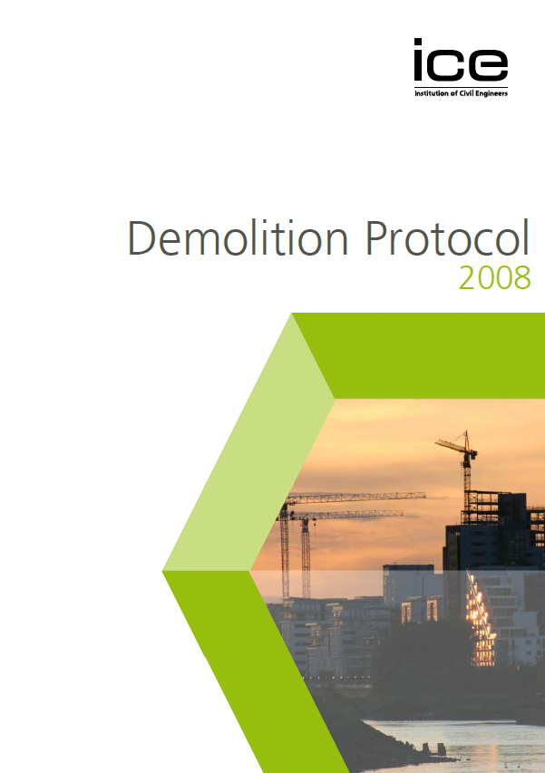
Building Layers
An opportunity for refurbishment
50% of construction work – repair and refurbishment (BCIS)
An important part of the sector with refurbishment an important consideration before demolition or new build.
ICE Demolition Protocol – suggests that consideration should be given to reuse/refurbishment.
One study suggests that 80% of the buildings that will exist in 2050, are already built.
Notes:
It is estimated 50% of all construction work carried out involves repair or refurbishment.
So in any project has an existing structure,often the immediate assumption is 2 Demolish the building and start afresh with a new structure. Building layers challenges this approach by introducing the concept that building's consists of layers on these individual layers can be removed at different stages in the project life cycle.
The approach is not new the most recent revision to the icy demolition protocol challenges us to consider If the opportunity exists to to reuse components or the existing a building.

Slide 6
Refurbishment
Can involve minor or cosmetic renovations, but also major repairs, extensions, adaptations through the repurposing of buildings.
By refurbishing a building – saves on the generation of waste and use of new materials
Maintains the value of the materials within the economic cycle – a circular economy principle
Notes:
From a circular economy perspective refurbishment open existing building makes sense it clearly generates less waste and avoid the use of new materials and in keeping with the principles of the circular economy keeps the materials in the economic cycle for longer.

Slide 7
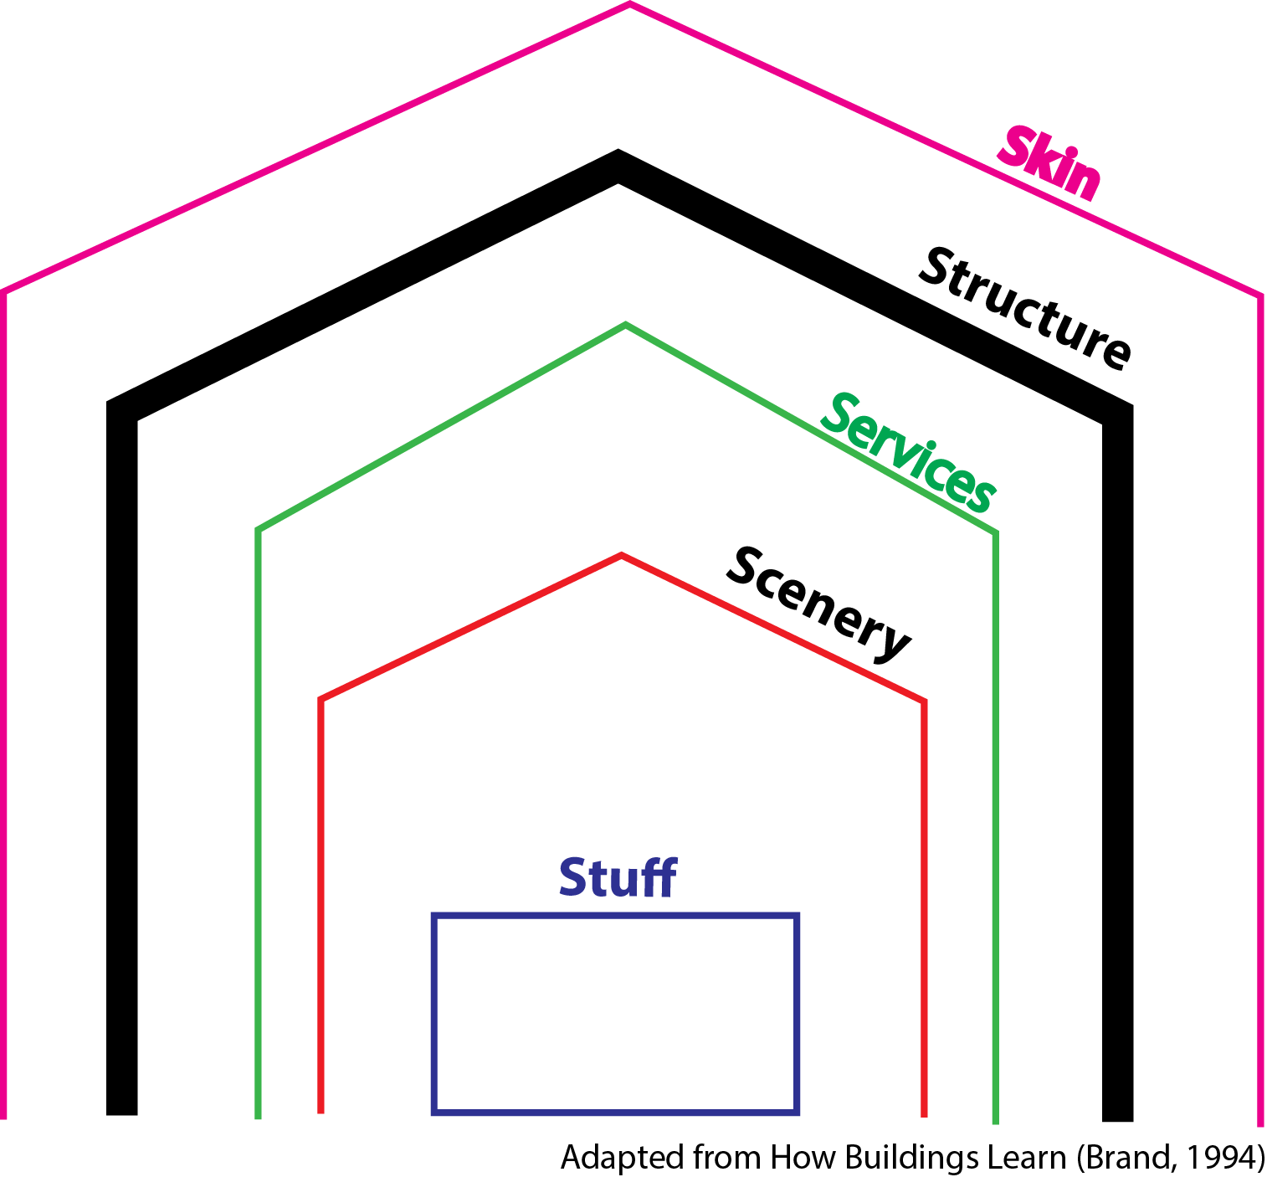
Building Layers
A useful concept is the idea of building layers
Buildings consist of individual layers, each with their own expected lifespan.
Notes:
A useful way of thinking about refurbishment is to consider the building as a number of layers.
Each layer has its own expected lifetime, with the figure illustrating what we mean .
First buildings will always have a structure, which provides structural integrity and not expected to change during the building’s life.
The building will also have skin or a façade. With services such as ventilations water supply electrical systems as another layer.
Within the building there will be petitioning and separation of rooms which we can refer to as scenery.
Finally we have stuff – furniture, office equipment etc to create an office space or a working environment.
It follows that stuff and office equipment will have the shortest life span and the scope for repositioning and changing the layout of rooms within a building services can be replaced the facade of the skin of the building can also be replaced in modernised but the structure after remaining tight for the longest period.

Slide 8
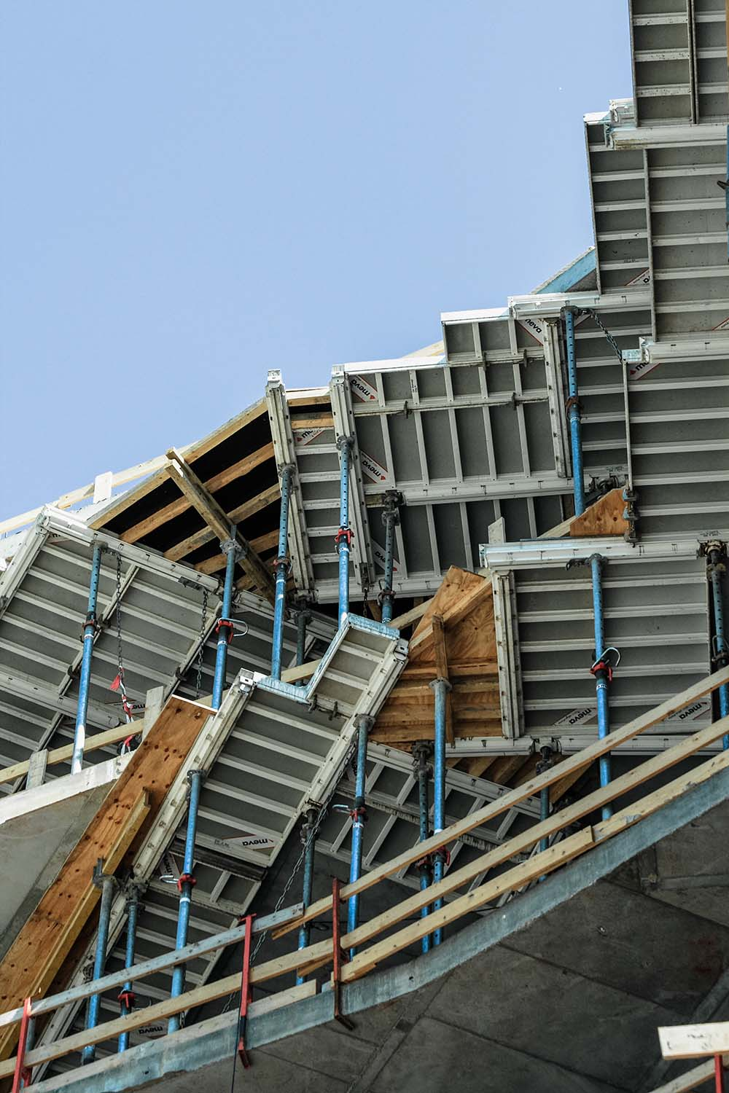
Who should consider Building Layers approach?
An Exercise – who should give consideration to refurbishment?
Clients, developers, leaseholders can consider refurbishment of some of the building layers as an option.
Designers/engineers can consider the structural design of a building from the perspective of extending a building’s life beyond the proposed design use
Notes:
As a discussion point the students should be asked to give thought as to who from the key stakeholders might be responsible for bringing the opportunity of bringing refurbishment on the building layer approach in 2 consideration.
The most obvious stakeholder will be the client, who may consider the approach Having good environmental credentials, or it may indeed be cheaper to refurbish than to rebuild .
The designer all the contractor may have built up considerable Experience around refurbishment and may offer this option.
However there may be the opportunity to take the long term view at the design stage, and have the designer purposely design the building with layers in mind.

Slide 9
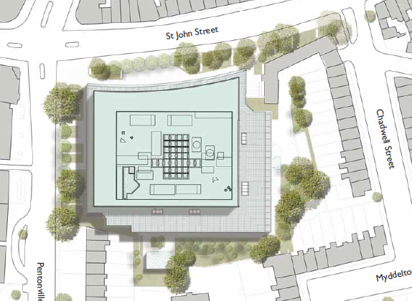
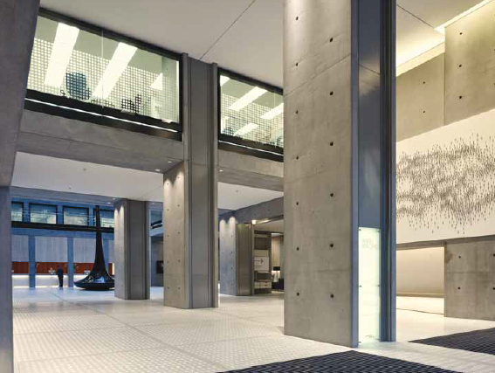
Case Study – Angel Building - London
A concrete 1970’s structure
Refurbished and completed in 2010
Retained concrete frame – reduced build – time, high thermal mass in concrete used to regulate air temperatures
Avoided 39,500 tonnes of waste concrete and 7,500 of CO₂
BREEAM Excellent
Information Pack on Build Life Cycle is here
Notes:
THe Angel Building is a major development in London, but illustrates the opportunity to repurpose an existing building and intergrate its features into a new working space. The students should check out the link which describes the history of the development.

Slide 10
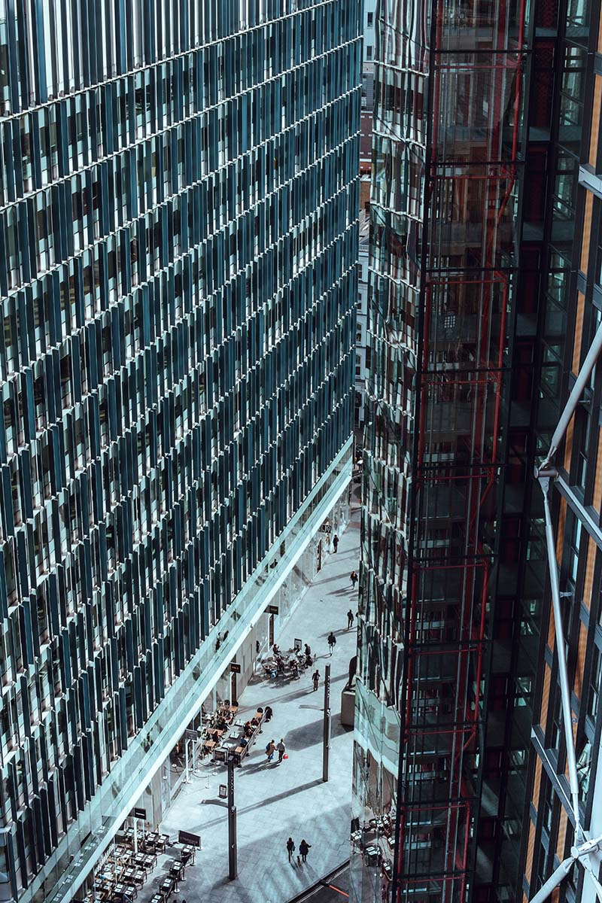
Conclusion
Workshop describes the opportunity for refurbishment and taking the building layer approach, likely to have an impact in the future evolution of the construction sector.
Refurbishment has an important role to play in the realisation of a circular construction sector, designing out waste, and building better buildings of high quality and importantly – built to last.

